Slide 1
Developing Inclusive Youth: Harnessing Social Cognition about Exclusion to Reduce Prejudice and Bias
Melanie Killen
Department of Human Development and Quantitative Methodology
SRCD Diversity Lecture
Dec 8, 2020

Slide 2
Inequity and Injustice in Childhood
Around the world, children experience
unfair treatment
discrimination
inequality
Children are both the victims and the perpetuators of unfair treatment

Slide 3
Correcting Misconceptions about Prejudice
“Children are colorblind and do not think about race”
Children can identify their own and others’ race from early in life, and become aware of status and bias early in childhood
“Children learn prejudice from adults”
Peer groups and societal messages perpetuate power hierarchies that often target other children to maintain status
“Children are unaware of inequalities and prejudice”
Children become aware of prejudice very early but also hold biases unbeknownst to them (or to adults)
“Children are self oriented and do not care about fairness, equality, and equity”
Children very much care about fair and equal treatment

Slide 4
Long term negative consequences
Unfair treatment, discrimination and social exclusion in childhood and adolescence are related to:
Individuals who perpetuate bias also have long term negative consequences in terms of stress in school and the workforce
depression and anxiety
stress and developmental delays
low academic motivation
social withdrawal
sleep disorders
Alfaro, et al., 2006; Fisher, et al., 2000; Neblett, et al., 2008; Russell, et al.,2010; Walton & Cohen,2011; Yip, 2014

Slide 5
Experiencing prejudice is a global health problem
Reducing prejudice and bias has positive benefits for the health of individuals, societies, and nations
Developmental science plays a crucial role regarding reducing prejudice and bias in childhood
Basic research and intervention

Slide 6
Addressing Prejudice in Childhood
What is prejudice?
What do we know about it in childhood and adolescence?
What types of intervention might reduce prejudice?

Slide 7
What is Prejudice?
Assigning traits, intentions, interests, and abilities to individuals based solely on group identity
“She’s an American so you know she will be very ______; they always are like that. We don’t want her in our group.”
Negative attitudes, biases, and exclusionary behavior based on group identity

Slide 8
How Early Does Prejudice Emerge?
Depends on how you measure it…
... there is no one “prejudice” test

Slide 9
Examples of Prejudice in Childhood
Use of stereotypes
“Girls can’t play with us ‘cause they’ll just cry”
Ingroup preference or bias “We get to play this game ‘cause you can’t even speak English”
Exclusion based on group membership - gender, race, ethnicity
“We don’t let Muslims in our group; they don’t know how to play kickball”
Explicit and implicit forms of prejudice
Brown, 2017; Dunham, Baron, & Carey, 2011; Liben & Bigler, 2002; Mulvey, 2016; Martin & Ruble, 2010; Pauker, Williams, & Steele, 2016

Slide 10
Prejudice is a Systemic Issue
Prejudice was initially characterized as a personality deficit
Social and developmental psychologists formulated it as a normative process
Prejudice emerges with group norms designed to create systemic status hierarchies, power, and privilege
Brown & Hewstone, 2005; Dovidio, et al., 2005; Elenbaas & Killen, 2016; Rowley, Kurtz-Costes, Mistry, & Feagans, 2007; Ruck, et al., 2010; Rutland & Killen, 2015

Slide 11
Prejudice Involves Identification with Groups
Ingroup Bias … Outgroup Distrust
Group Affiliation
Group Loyalty
Support
Protection
Safety
Ingroup Preference
Solidarity
Alliances
Exclusion of ingroup members as well as outgroups
Abrams & Rutland, 2008, 2011; Elenbaas, Rizzo, & Killen, 2020; Gaertner & Dovidio, 2005; Nesdale, 2004, 2008; Mulvey, Palmer, & Abrams, 2016; Rutland & Killen, 2017; Tajfel & Turner, 1979; Turner & Cameron, 2016; Verkuyten & Thijs, 2019

Slide 12
Social Reasoning Developmental (SRD) Model
Moral
Fairness, Equality, Others’ Welfare, Equity, (In)Justice
Child
Societal
Group Identity, Group Norms
Psychological
Attributions of Others’ Intentions
Elenbaas, Rizzo, & Killen, 2020; Killen, Mulvey, & Hitti, 2013; Killen & Rutland, 2011; Nucci, 2009; Rutland & Killen, 2015; Smetana, 2015; Turiel, 2015

Slide 13
Global Basis of Research on Social Exclusion
Research on social exclusion has been conducted in:
Australia, Austria, Canada, China, Colombia, Czech Republic, Cyprus, Denmark, Germany, Israel, Japan, Jordan, Korea, Lebanon, Nepal, Northern Ireland, The Netherlands, Palestinian Territories, Spain, South Africa, Switzerland, Turkey, U.K., U.S.
Universality of individual-group dynamics that leads to group affiliation as well as group biases

Slide 14
Areas of Convergence
Social Justice &
Group Identity
Ethnic & Racial
Identity
Origins of
Prejudice

Slide 15
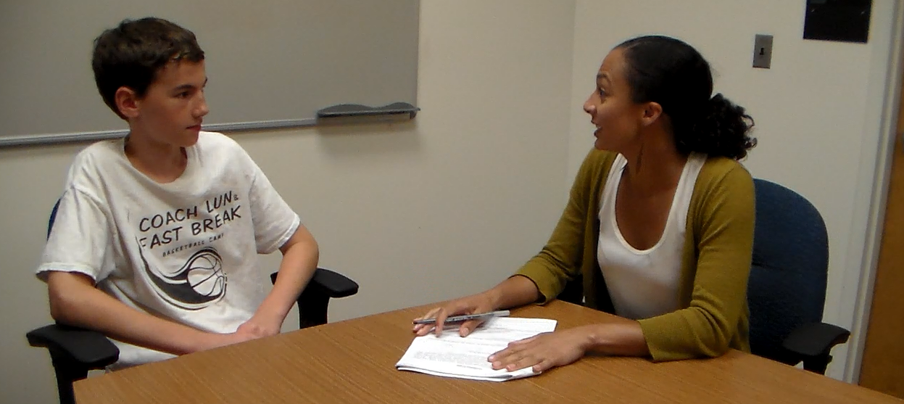
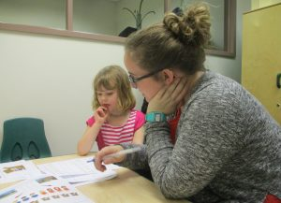
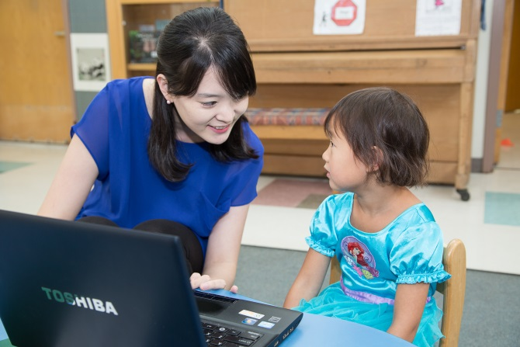
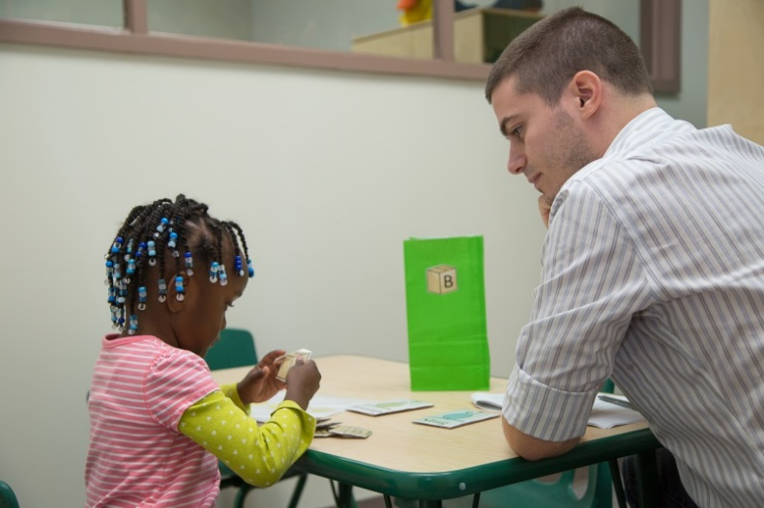
What do We know about Prejudice in Childhood?

Slide 16
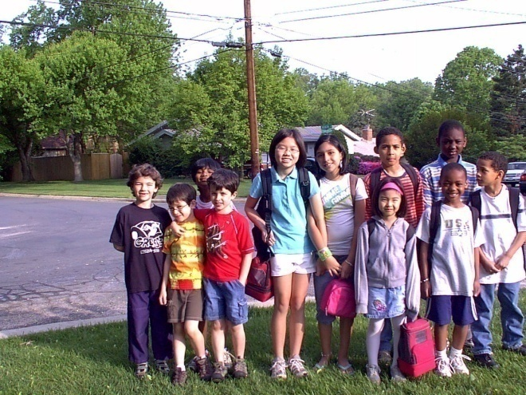
What Do we Know about Social Exclusion and Prejudice?
1) Biases in peer encounters
2) Evaluations of social inclusion and exclusion
3) Expectations about outgroup inclusion
What types of biases do children
hold regarding interracial peer encounters?

Slide 17
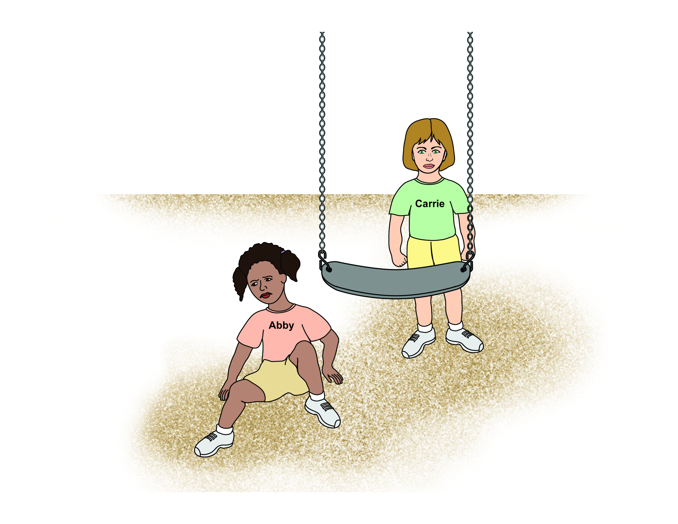
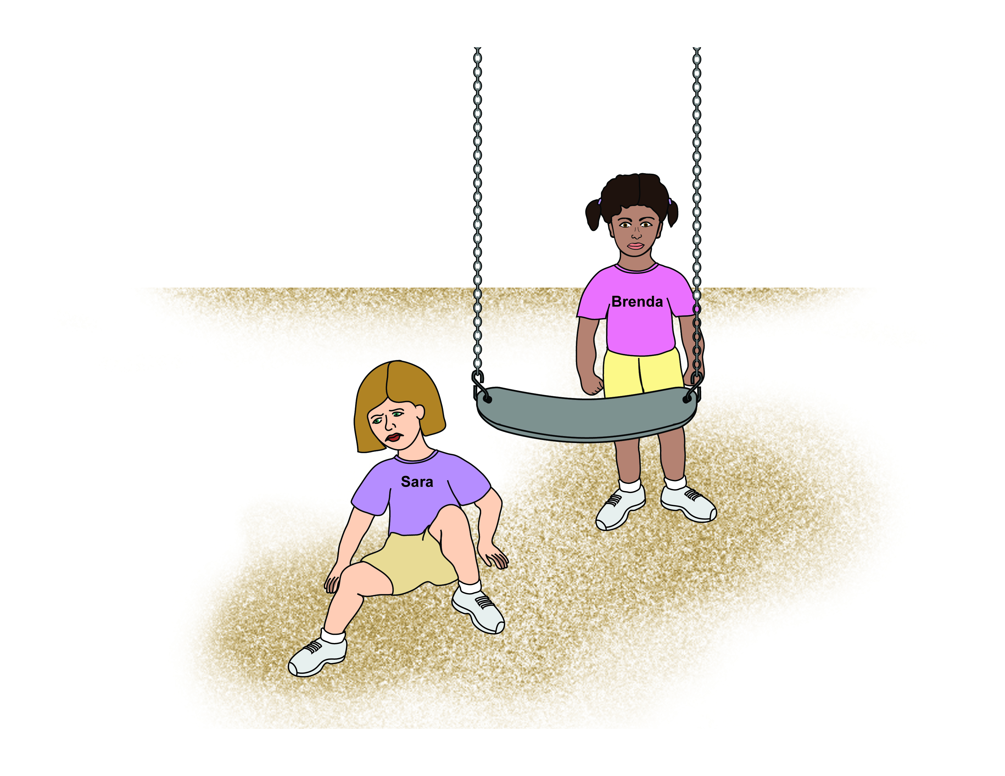
Biases in Peer Encounters: Attributions of Intentions
What is happening in this picture?
…and in this picture?
McGlothlin & Killen, 2006, Child Development; 2010, European J of Social Psychology © 2010 Joan Tycko, Illustrator

Slide 18
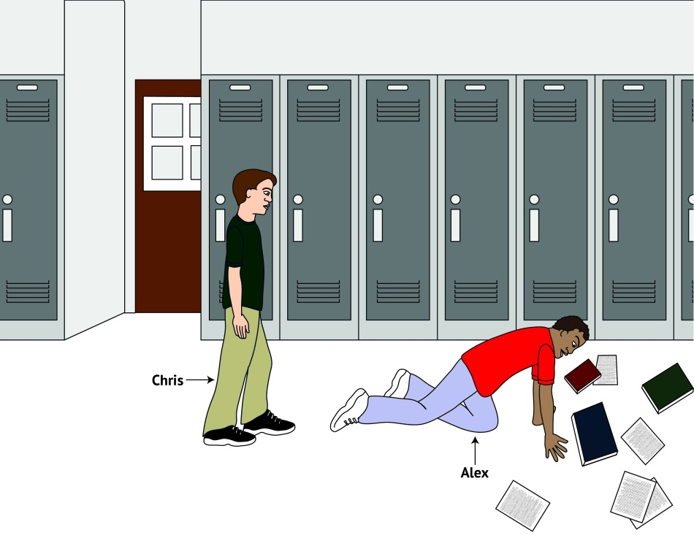
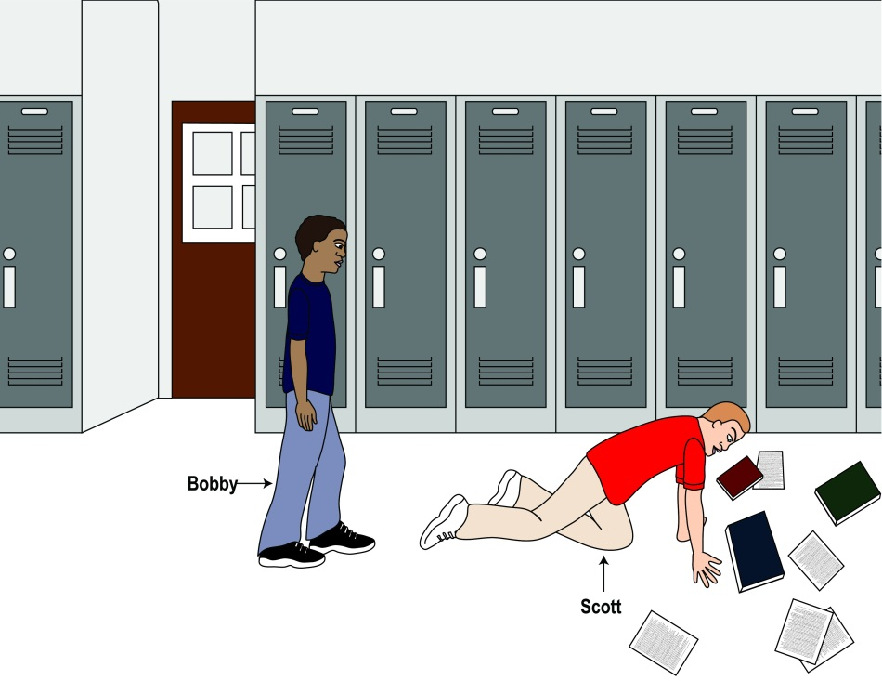
…and this picture?
Killen, Kelly, Richardson, & Jampol, 2010, Developmental Psych © 2010 Joan Tycko, Illustrator

Slide 19
Attribution of Intentions: 7-10 year olds, N = 302
What happened?
“Carrie pushed Abby off the swing.”
What will happen next?
“Abby will push her back”
Can they be friends?
No
Negative intentions
“Abby fell off the swing and Carrie will help her up.”
What will happen next?
“Abby will get back on the swing.”
Can they be friends?
Yes
Positive intentions
Tested in Majority White Schools and Mixed Ethnicity Schools
McGlothlin & Killen, 2006, Child Development; 2010, European J of Social Psychology © 2010 Joan Tycko, Illustrator

Slide 20
Attributions of Intentions Based on Race

Slide 21
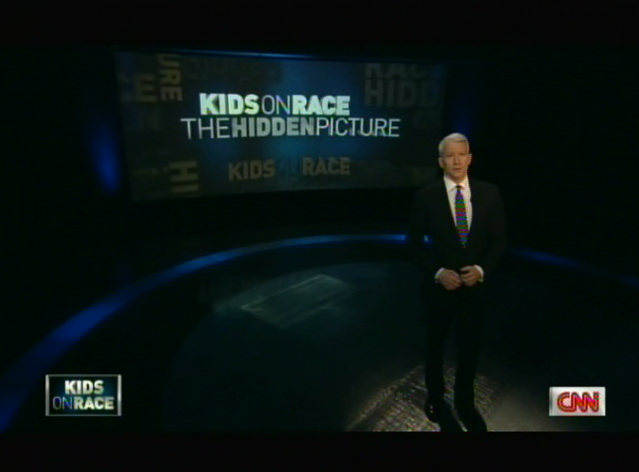
CNN AC360: Kids on Race: The Hidden Picture
Commissioned my team to interview 145 6-year and 13-year olds in Maryland, New Jersey, and Virginia
http://ac360.blogs.cnn.com/category/kids-on-race/
Parents who were interviewed
said: “It’s a wake-up call.”

Slide 22
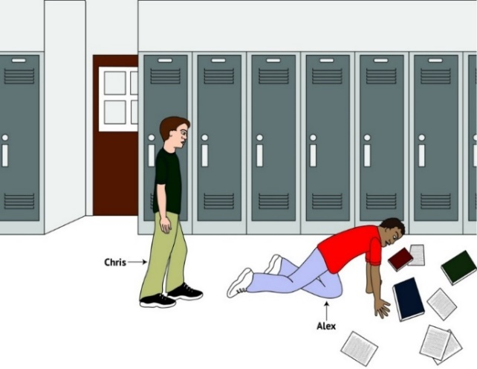
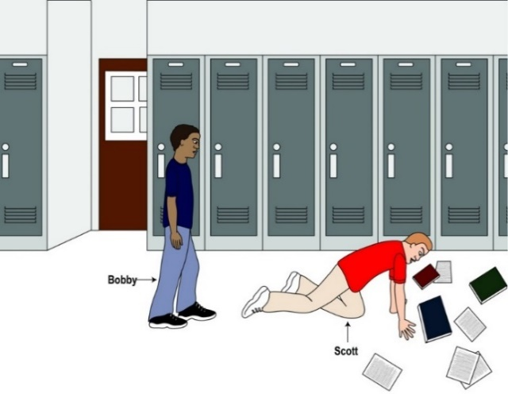
What have we Learned?
Biases exist in the context of interracial peer encounters
Children in mixed ethnicity schools think cross-race friends more likely
What happens when we ask kids to evaluate social inclusion in same-race and interracial peer encounters?...
© J.M.K. Tycko

Slide 23
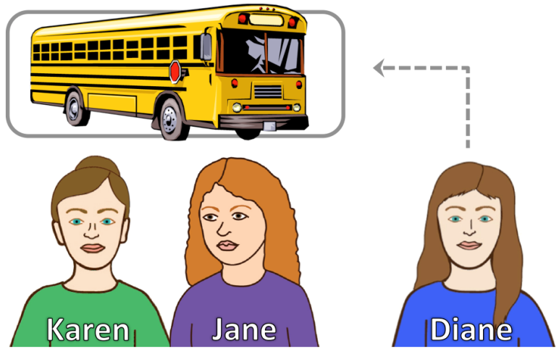
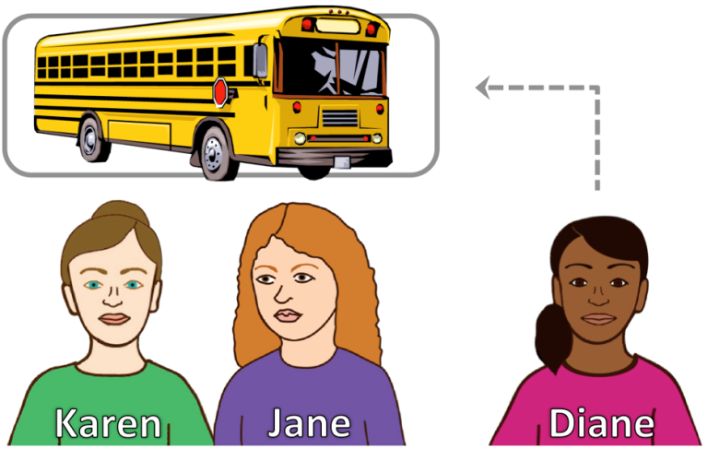
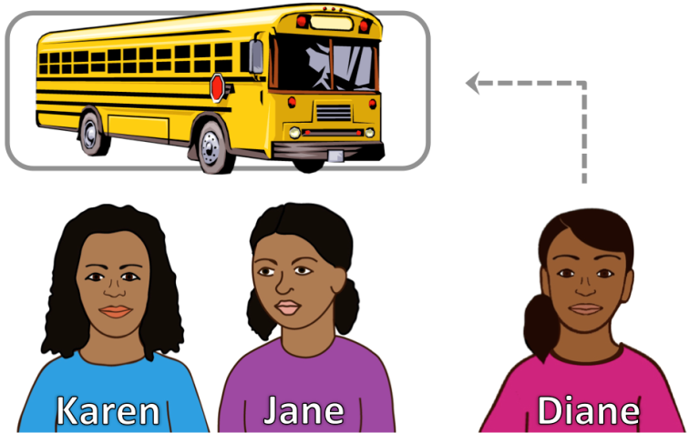
Evaluations of Same-Race and Interracial Social Inclusion and Exclusion
How likely is it that Karen will ask Diane to sit with them?
N= 246; 9-11 years and 12-14 years
115 Af Am; 131 Euro-Am
Cooley, Burkholder & Killen, 2019, Dev Psychology

Slide 24
How likely will Karen invite Diane to sit with them? 12-14 yrs (n = 127 out of 246)
Very likely
Very unlikely
Peer Composition Encounter
Cooley, Burkholder & Killen, 2019, Dev Psychology

Slide 25
What have We Learned So Far?
des
White adolescents think it’s more likely to include another same-race peer than a different race peer….
…when a same-race friend discourages it
African-American students do not make this same distinction
What is it that leads to these type of preferences?
“We don’t have much in common…”
Abrams & Rutland, 2008; Rutland, et al., 2010; Nesdale, 2004; Nesdale & Lawton, 2011

Slide 26
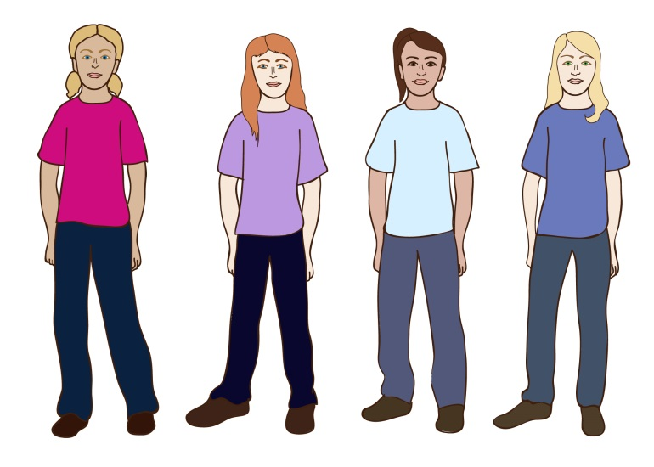
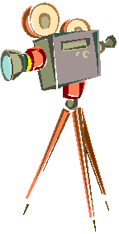
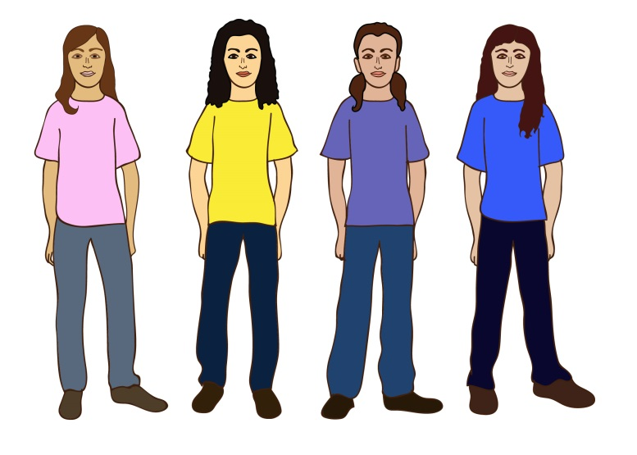
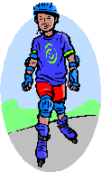
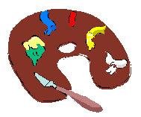
“We don’t have much in common”
This is your group:
American group of friends
Your group likes these activities:
This is the other group:
مجموعة أصدقاء عرب
“Arab American group of friends”
This group likes these activities:
Diana
Sandra
Katie
Angela
Samya
Jeenan
Diyala
Reema
Hitti & Killen, 2015, Child Development
© 2011 J.M.K. Tycko, Illustrator

Slide 27
Pitting Cultural Membership with Shared Interests
How likely to include?
Target 1
Target 2
مجموعة أصدقاء عرب
“Arab American group of friends”
American group of friends
Diana
Sandra
Katie
Angela
Samya
Jeenan
Diyala
Reema
Arab American
American
Layla
Hannah
Hitti & Killen, 2015, Child Development
© 2011 J.M.K. Tycko, Illustrator

Slide 28
“My Group Would Include Others but Their Group Would Not”
Really Likely
Arab American
***
***
*
*
American
Layla
Really Not
Likely
Hannah
Hitti & Killen, 2015, Child Development
Notes:
Judgments match their reasoning

Slide 29
“They Prefer to Hang Out with their Own Kind”
des
Group identity
American adolescents assume that an Arab outgroup would be exclusive (“they prefer their own kind”).
53% of the sample reported stereotypic associations about Arabs
American
Arab American
Hannah
Layla
Hitti & Killen, 2015, Child Development

Slide 30
School Composition and Intergroup Contact
Cross-group contact (friendships) reduces bias
Benefits for racial /ethnic majority groups for friendship potential
Effective for minority groups regarding inter-ethnic friendships
Ethnic and racially diverse school compositions have multiple benefits for all students: safety, support, academic motivation
Jugert, Noack, & Rutland, 2011; Grütter, Gasser, Zuffiano, & Meyer, 2018; Juvonen, Nishina, & Graham, 2006; Ruck, Park, Killen, & Crystal, 2011; Tropp & Pettigrew, 2005; Turner & Cameron, 2016

Slide 31
A Window of Opportunity
Stereotypes, biases, and exclusionary attitudes are difficult to change by adulthood
Understanding prejudice from early childhood to adolescence is crucial
The time for intervention is in childhood…

Slide 32
Promoting Intergroup Friendships and Reducing Prejudice in Childhood
Developing Inclusive Youth (DIY) @umd.edu
Web-based curriculum tool
Teacher-led classroom discussions
Randomized Control Trial (RCT)
8 - 11 year olds (3rd, 4th, 5th grades)
48 classrooms
P.I.s, Killen, Stapleton, & Sweet. Team: Burkholder, D’Esterre, Elenbaas, Glidden, Luken-Raz, Rizzo, Samuelson, Sims, Woodward, Yee

Slide 33
Two Studies
Developing Inclusive Youth (DIY) @umd.edu
Study 1 (completed):
N = 982 participants
60% Majority White, 40%, Ethnic/Racial Minority
Study 2 (in progress):
No numeric majority group:
African-Am, Asian-Am, Euro-Am, Latinx, Multiracial
P.I.s, Killen, Stapleton, & Sweet. Team: Burkholder, D’Esterre, Elenbaas, Glidden, Luken-Raz, Rizzo, Samuelson, Sims, Woodward, Yee

Slide 34
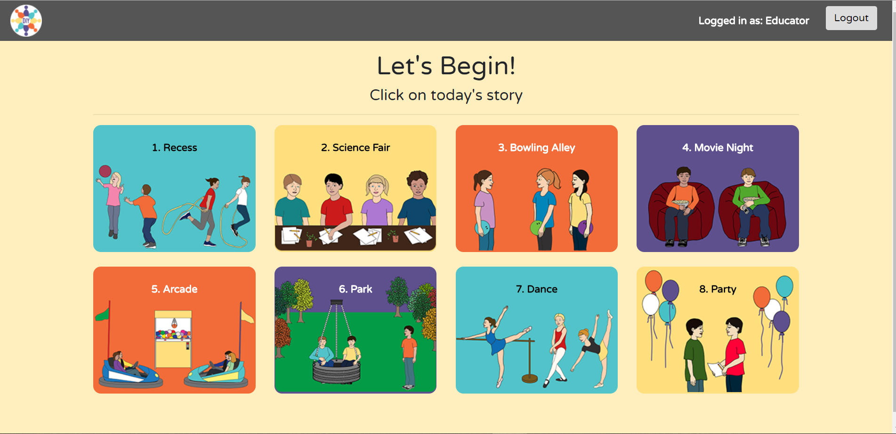
Killen, et al., 2020; © J. Tycko, Illustrations, 2018

Slide 35
Killen, et al., 2020; © J. Tycko, Illustrations, 2018

Slide 36
Killen, et al., 2020; © J. Tycko, Illustrations, 2018

Slide 37
Killen, et al., 2020; © J. Tycko, Illustrations, 2018

Slide 38
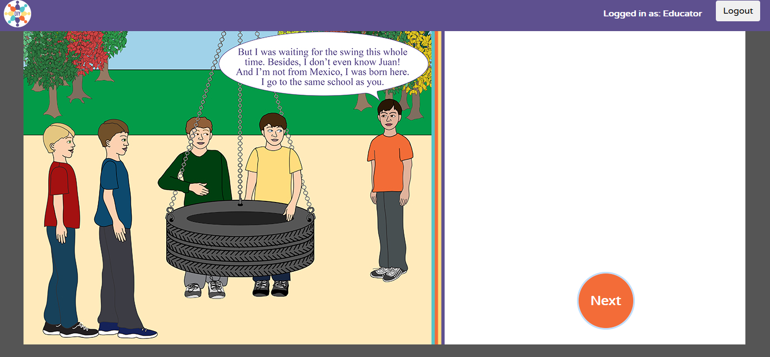
Killen, et al., 2020; © J. Tycko, Illustrations, 2018

Slide 39
Killen, et al., 2020; © J. Tycko, Illustrations, 2018

Slide 40
Killen, et al., 2020; © J. Tycko, Illustrations, 2018

Slide 41
Killen, et al., 2020; © J. Tycko, Illustrations, 2018

Slide 42
Children choose whether to include or exclude and see it play out

Slide 43
Killen, et al., 2020; © J. Tycko, Illustrations, 2018

Slide 44
Killen, et al., 2020; © J. Tycko, Illustrations, 2018

Slide 45
Killen, et al., 2020; © J. Tycko, Illustrations, 2018

Slide 46
The scenario returns to the other option and plays it out

Slide 47
Killen, et al., 2020; © J. Tycko, Illustrations, 2018

Slide 48
Killen, et al., 2020; © J. Tycko, Illustrations, 2018

Slide 49
Developing Inclusive Youth
Voice-over, animated peer exclusion and inclusion scenarios
Teacher-led discussion following the use of the tool
for 30 minutes
Sitting in a circle in front of classroom
Teacher Training Workshop, Guided Charts for Discussion, Weekly Feedback

Slide 50
Killen, et al., 2020; © J. Tycko, Illustrations, 2018

Slide 51
Classroom Conversations: 8 – 11 year olds
Inclusive
Anti-stereotypes “People are not good or bad because of their skin color”
Broader Societal Issues “A lot of times movies have Arabs as the bad guys because the news always shows Arabs in war.”
Demonstrating Empathy “I really feel bad that the kid was excluded.”
Promoting Inclusive Behavior “If I saw someone not letting someone play because of their race I'd tell them it's wrong and breaks the Golden Rule”

Slide 52
Classroom Conversations
Exclusive
Perpetuating Stereotypes “The stereotype is that Asians are smart and that’s good for Asians.”
Denying Broader Societal Issues “Well race doesn’t really affect you in the U.S.A.”
Lacking Empathy “If she is bad at dancing then it’s good to exclude her because sometimes life is hard -you have to deal with it.”
Justifying Exclusive Behavior “You can exclude mean people, you know.”

Slide 53
Classroom Conversations
Personal Experiences
“They told me I couldn’t play with them because I am a girl and girls can’t play soccer.”
“I have a friend who is black. Even though he looks different than me, we are still best friends"
“My friends said I was too fat to play soccer with them”
“Groups of guys assumed I didn't like Star Wars and it made me feel left out.”

Slide 54
Randomized Control Design
Design | Week 1 | Week 2 | Week 3 | Week 4 | Week 5 | Week 6 | Week 7 | Week 8 | Week 9 | Week 10
DIY | Pretest | DIY | DIY | DIY | DIY | DIY | DIY | DIY | DIY | Post-test
BAU | Pretest | BAU | BAU | BAU | BAU | BAU | BAU | BAU | BAU | Post-test
DIY = Developing Inclusive Youth intervention program
BAU = Business-as-Usual control group

Slide 55
Outcome Variables
Social Inclusion and Exclusion
Trait Attributions
Math and Science Competency Beliefs
Reported Play Contact with Diverse Peers

Slide 56
Regression coefficients for differences between the DIY program group and the BAU control group on the outcome variables, overall
 | Likelihood of Interracial Peer Inclusion | Evaluation of Interracial Peer Exclusion | Traits for Gender Ingroup | Traits for Gender Outgroup | Traits for Ethnic Groups | Math and Science Beliefs - Female | Math and Science Beliefs - Black | Reported Contact with Diverse Peers
Treatment Effect | 2.16 (0.32) | -1.11 (0.28) | 0.56 (0.17) | 0.52 (0.17) | 0.80 (0.23) | 0.10 (0.05) | 0.11 (0.05) | 0.18 (0.11)
Significance | p < .001 | p < .001 | p = .001 | p = .002 | p = .002 | p = .04 | p = .04 | p = .08
Killen, et al., 2020

Slide 57
Regression coefficients for differences between the DIY program group and the BAU control group on the outcome variables, overall
 | Likelihood of Interracial Peer Inclusion | Evaluation of Interracial Peer Exclusion | Traits for Gender Ingroup | Traits for Gender Outgroup | Traits for Ethnic Groups | Math and Science Beliefs - Female | Math and Science Beliefs - Black | Reported Contact with Diverse Peers
Treatment Effect | 2.16 (0.32) | -1.11 (0.28) | 0.56 (0.17) | 0.52 (0.17) | 0.80 (0.23) | 0.10 (0.05) | 0.11 (0.05) | 0.18 (0.11)
Significance | p < .001 | p < .001 | p = .001 | p = .002 | p = .002 | p = .04 | p = .04 | p = .08
Killen, et al., 2020

Slide 58
Regression coefficients for differences between the DIY program group and the BAU control group on the outcome variables , overall
 | Likelihood of Interracial Peer Inclusion | Evaluation of Interracial Peer Exclusion | Traits for Gender Ingroup | Traits for Gender Outgroup | Traits for Ethnic Groups | Math and Science Beliefs - Female | Math and Science Beliefs - Black | Reported Contact with Diverse Peers
Treatment Effect | 2.16 (0.32) | -1.11 (0.28) | 0.56 (0.17) | 0.52 (0.17) | 0.80 (0.23) | 0.10 (0.05) | 0.11 (0.05) | 0.18 (0.11)
Significance | p < .001 | p < .001 | p = .001 | p = .002 | p = .002 | p = .04 | p = .04 | p = .08
Killen, et al., 2020

Slide 59
Regression coefficients for differences between the DIY program group and the BAU control group on the outcome variables , overall
 | Likelihood of Interracial Peer Inclusion | Evaluation of Interracial Peer Exclusion | Traits for Gender Ingroup | Traits for Gender Outgroup | Traits for Ethnic Groups | Math and Science Beliefs - Female | Math and Science Beliefs - Black | Reported Contact with Diverse Peers
Treatment Effect | 2.16 (0.32) | -1.11 (0.28) | 0.56 (0.17) | 0.52 (0.17) | 0.80 (0.23) | 0.10 (0.05) | 0.11 (0.05) | 0.18 (0.11)
Significance | p < .001 | p < .001 | p = .001 | p = .002 | p = .002 | p = .04 | p = .04 | p = .08
Killen, et al., 2020

Slide 60
Implications
The Intervention program was successful in changing children’s intergroup attitudes and reducing prejudice
New Directions:
Minority-majority schools
Teacher Beliefs
Analyses of Classroom Discussions

Slide 61
Broader Implications
Facilitating cross-group friendships is essential for the global, diverse world of childhood and adulthood
Reducing bias also involves promoting concepts of fairness and equality in everyday social interactions
Reducing prejudice in childhood creates healthy children and a more just and civil society

Slide 62
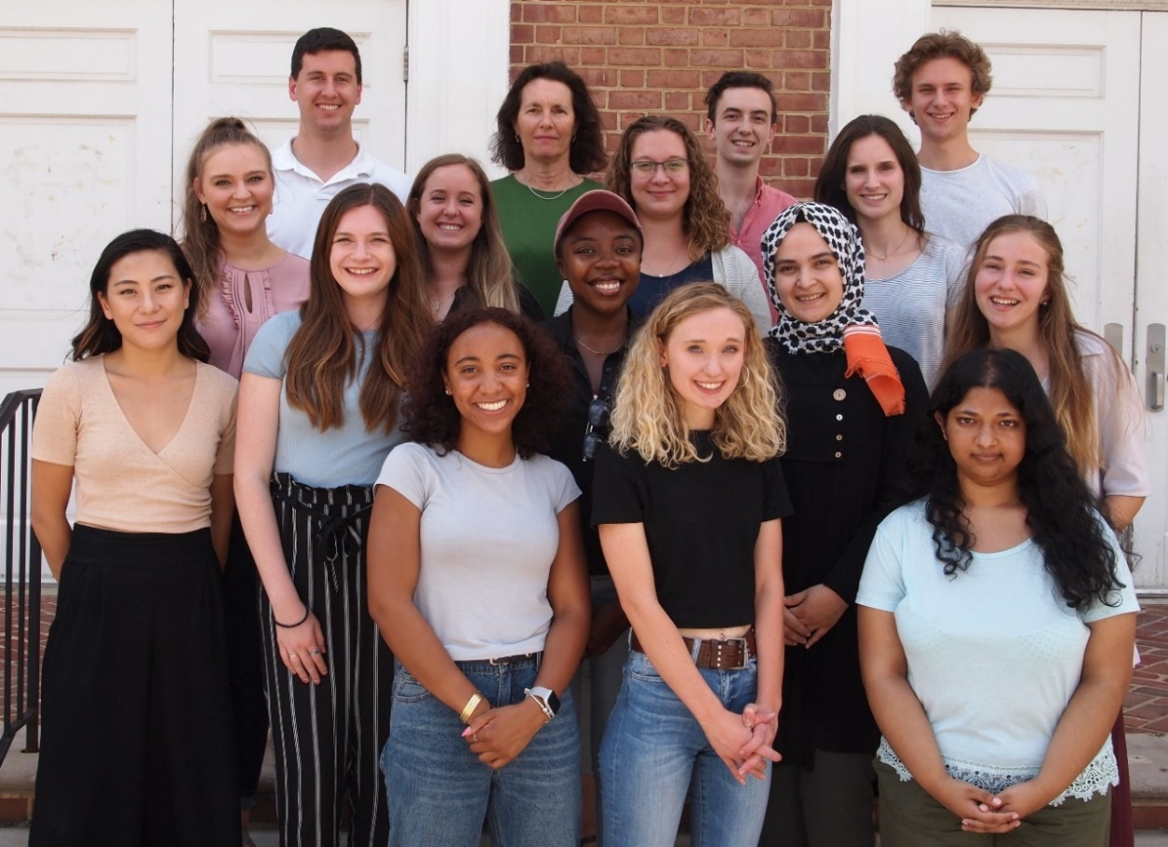
Acknowledgements
Current Doctoral Students:
Amanda R. Burkholder, Alex D’Esterre,
Jacquelyn Glidden, Kate Luken Raz,
Riley N. Sims, Kat Yee
Lab Managers: Bonnie Woodward, Arvid Samuelson
Thank you
Advisory Board: Christia Spears Brown, Laura Elenbaas, Jeanine Grütter, Lenka Kollerová, Michael T. Rizzo, Martin D. Ruck, Adam Rutland, Judi Smetana, Laura Stapleton, Tracy Sweet, Tiffany Yip
Collaborators: Aline Hitti, Kelly Lynn Mulvey, Shelby Cooley, Sally Palmer, Luke McGuire

