Slide 1
When The Goal is Racial Justice:
Learning from Youth, Families, and Educators
Deborah Rivas-Drake, Ph.D.
University of Michigan
SRCD Child Development in a Diverse Majority Lecture
December 8, 2020
@DrRivasDrake | drivas@umich.edu

Slide 2
Advancing Justice
Naming the Problem
Identifying Community Assets
Learning from Youth
Learning from Families
Learning from Educators

Slide 3
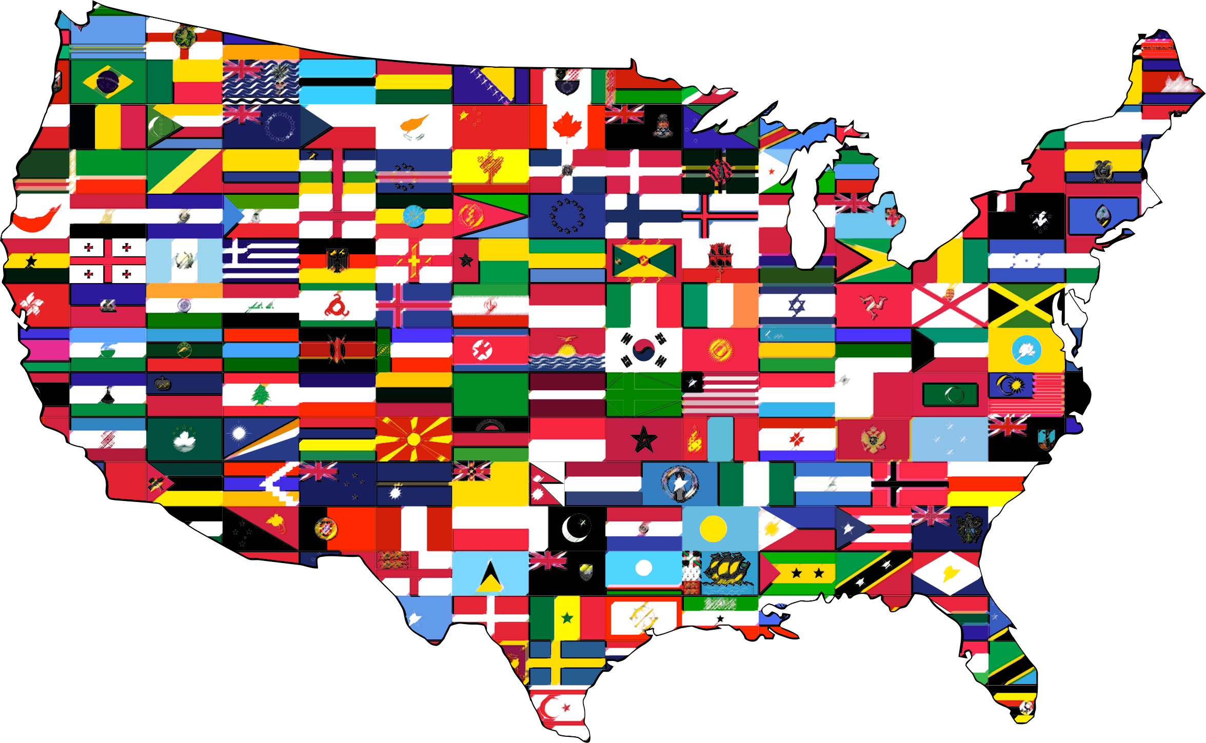
Coming of Age in a Changing U.S.
Youth
Family
Educators
Assets
Problem

Slide 4

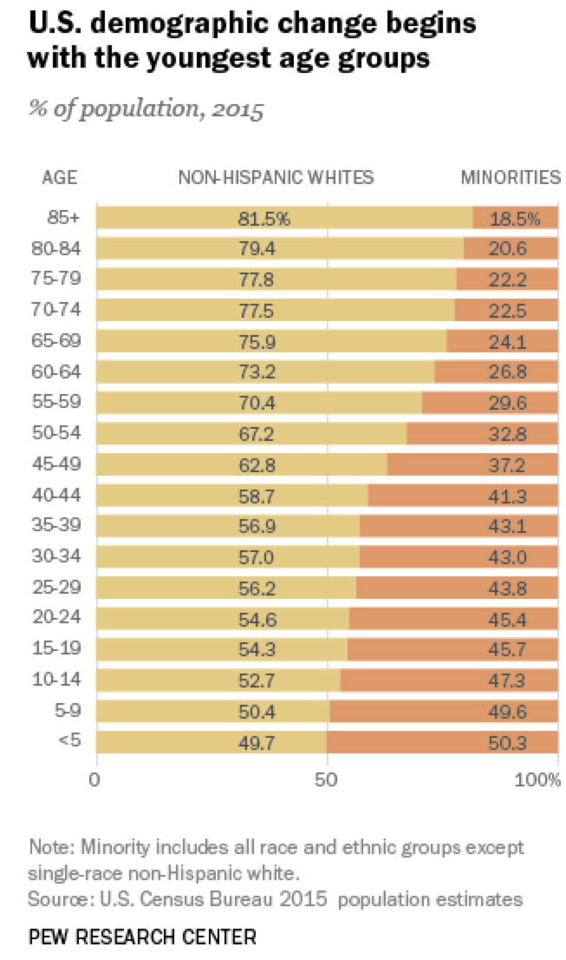
Kindergarteners of today….
Youth
Family
Educators
Assets
Problem

Slide 5
BUT…

Slide 6
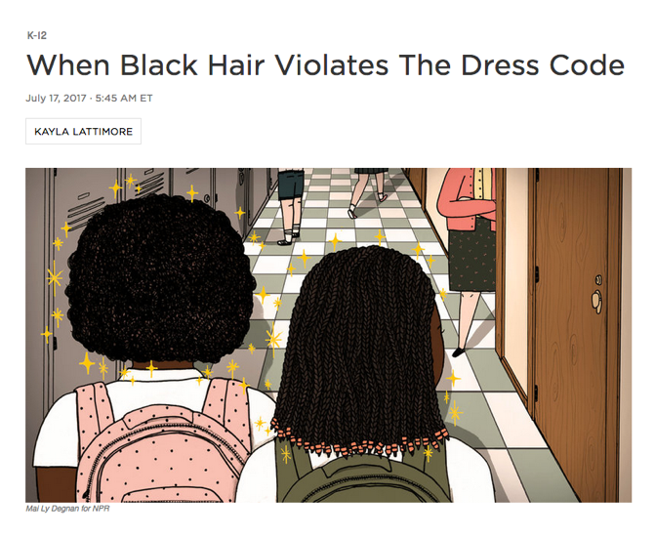
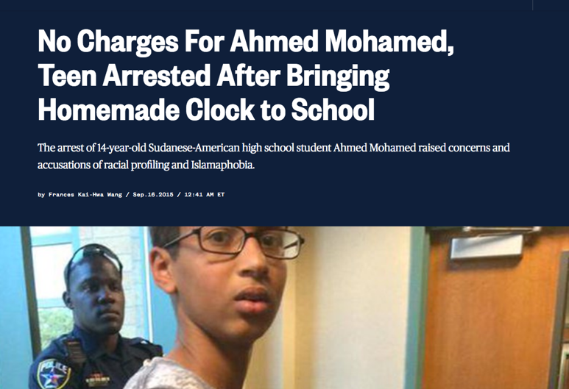
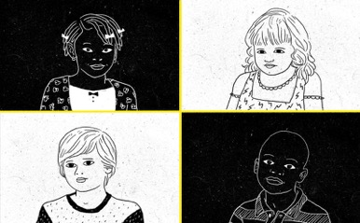
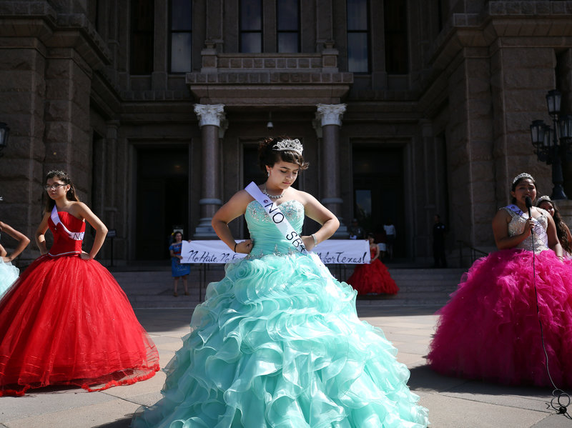
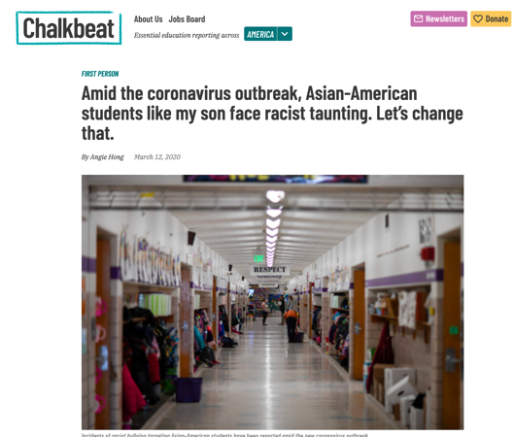
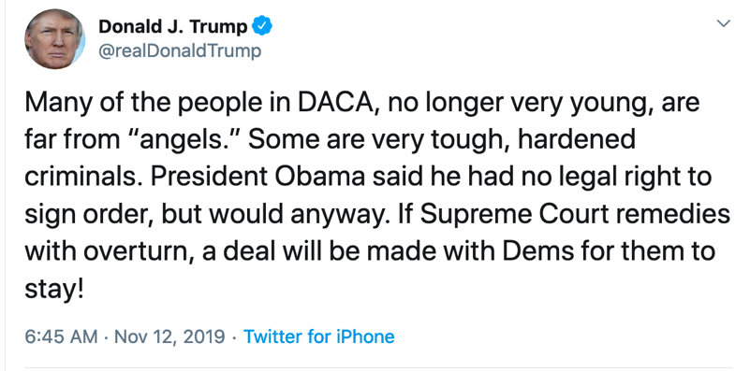
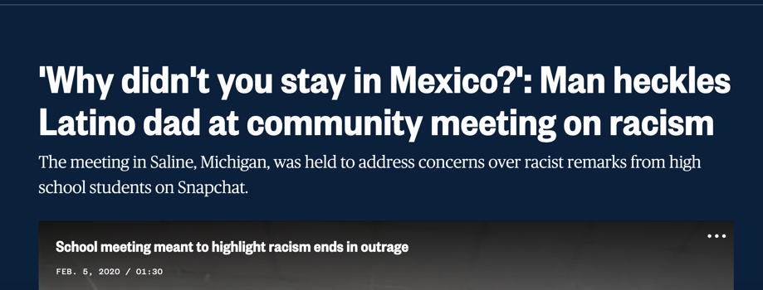
“Bias Isn’t Just a Police Problem, It’s a Preschool Problem”
“Quinceañeras Protest Texas Sanctuary City Ban”

Slide 9
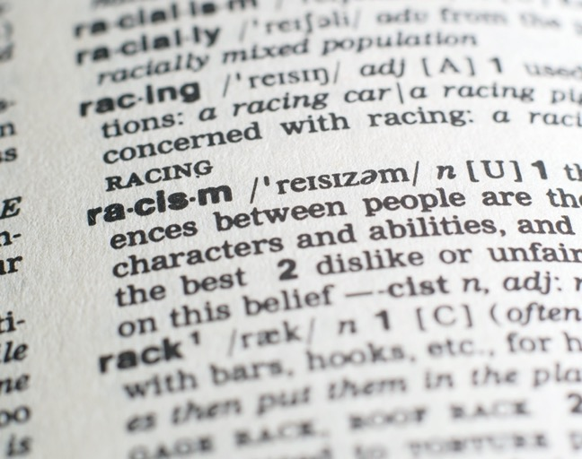
Name the problem
explicitly.
Youth
Family
Educators
Assets
Problem

Slide 10
“Avoidable and unfair inequalities in power, resources and opportunities”
Beliefs, emotions, behaviors, practices
“Reject, exclude and often vilify persons, based on the perception…
they are outsiders or foreigners”
Subjugation and subordination
Name the problem
explicitly.
Priest et al., 2013; UNESCO
Youth
Family
Educators
Assets
Problem

Slide 11
Hate Crimes Motivated by Race, Ethnicity, or Ancestry
Early Childhood
Adolescence
Youth
Family
Educators
Assets
Problem

Slide 12
Hate Crimes Motivated by Race, Ethnicity, or Ancestry
Source: https://www.fbi.gov/services/cjis/ucr/hate-crime (Table 1; 2004-2019)
Youth
Family
Educators
Assets
Problem

Slide 13
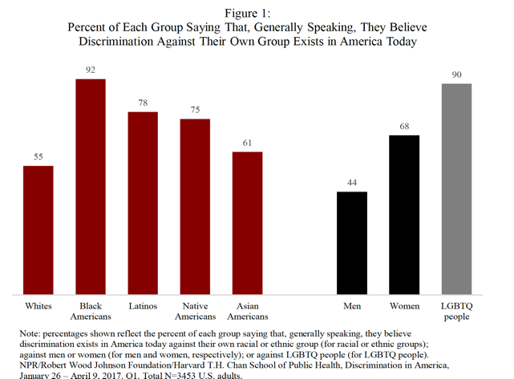

Believe People When They Tell You
Racism & Xenophobia Are Real
Source: https://www.rwjf.org/en/library/research/2017/10/discrimination-in-america--experiences-and-views.html
Youth
Family
Educators
Assets
Problem

Slide 14


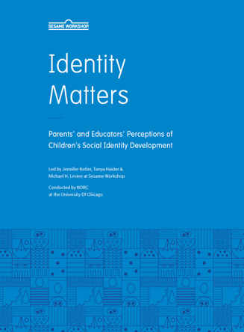

Racism and Xenophobia Are REAL…
Youth
Family
Educators
Assets
Problem

Slide 15

Racism and Xenophobia Are REAL…
“Over 2,500 educators described specific incidents of bigotry and harassment…includ[ing] graffiti…assaults on students and teachers, property damage, fights and threats of violence”
Source:
Youth
Family
Educators
Assets
Problem

Slide 16

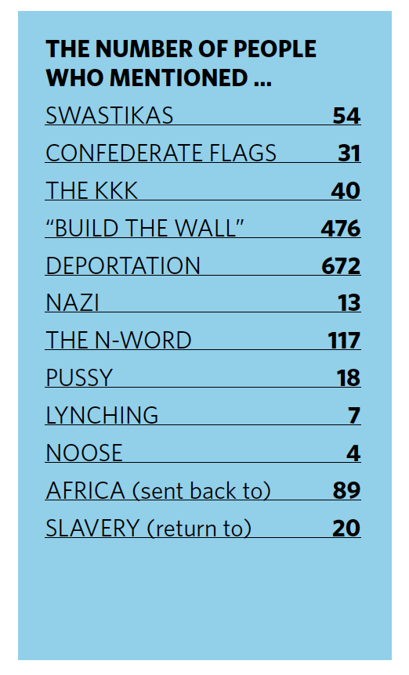
Racism and Xenophobia Are REAL…
Source:
Youth
Family
Educators
Assets
Problem

Slide 17

Racism and Xenophobia Are REAL…
WITNESSED BY EDUCATORS
1,087 (33%)
Race- or ethnicity-related
581 (18%)
Anti-immigrant
Youth
Family
Educators
Assets
Problem

Slide 18
Racism and Xenophobia Are REAL…
IN THE MEDIA
545 (67%)
Race- or ethnicity-related
OR
Anti-immigrant
Youth
Family
Educators
Assets
Problem

Slide 19
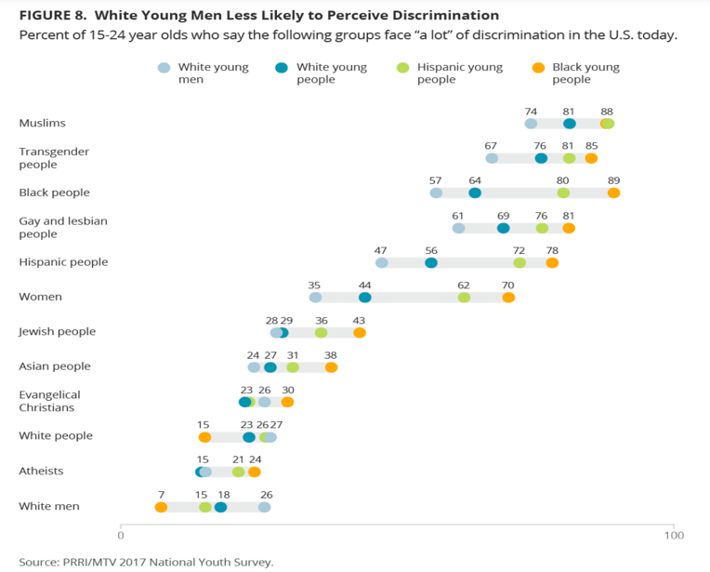

Jones et al., 2018. Diversity, Division, Discrimination: The Sate of Young America.
Youth
Family
Educators
Assets
Problem

Slide 20
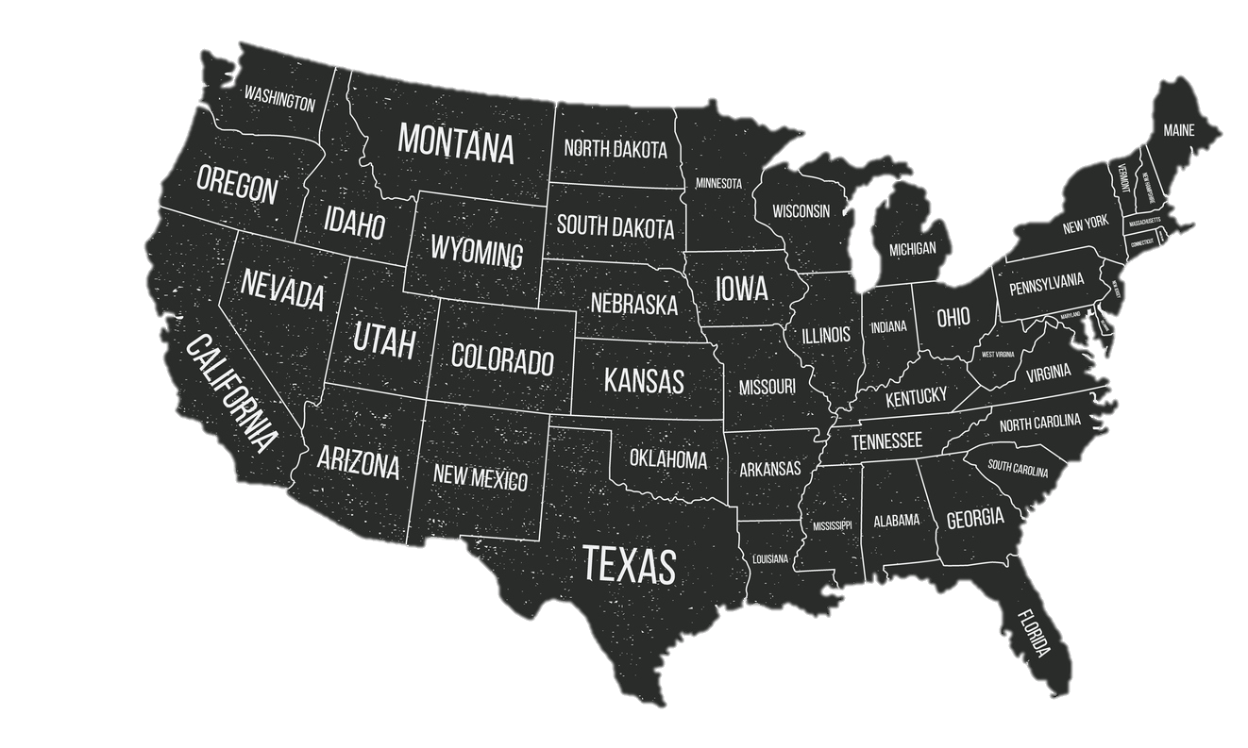
It’s Real for Many Youth
Of 15-24 year olds in 2017:
81%
Black
71%
Latinx
75%
AA/PI
Had experienced it themselves or
seen someone targeted due to their race or ethnicity
in the past 12 months
Boutwell et al., 2017; see also Pérez et al., 2008; Seaton et al., 2008
Youth
Family
Educators
Assets
Problem

Slide 21
Peer, School, and Societal Discrimination
among Latinx Youth (Ever Happened)
A few times
Once or Twice
Never
Time 1
Time 2
Time 3
Hoffman et al., in prep
Youth
Family
Educators
Assets
Problem

Slide 22
Perceived Discrimination & Foreigner Objectification
among Latinx Youth (In Past Year)
Three-Four Times
Once or Twice
Never
2014
2015
2016
Constante et al., under revision
Youth
Family
Educators
Assets
Problem

Slide 23
Perceived Discrimination & Foreigner Objectification
Ever In Past Year
Constante et al., under revision
Youth
Family
Educators
Assets
Problem

Slide 24
Perceived Discrimination & Future Barriers Over Time
W1 ERD
W1 BARR
.73 (.18) ***
1
1
W2 ERD
W2 BARR
1
1
ERD
INT
BARR
INT
W3 ERD
1
1
W3 BARR
.87 (.42) *
W1 ERD
0
ERD
SLP
BARR
SLP
0
W1 BARR
1
1
W2 ERD
2
W2 BARR
2
W3 ERD
W3 BARR
Standardized coefficient and standard error. CFI = .932, SRMR= .065, RMSEA (CI 90%) = 0.09 (0.05, 0.14). *p < .05. ***p < .001.
Constante et al., under revision
Youth
Family
Educators
Assets
Problem

Slide 25
Perceived Discrimination & Future Barriers Over Time
W1 ERD
W1 BARR
.44 (.13) ***
1
1
W2 ERD
W2 BARR
1
1
FOBJ
INT
BARR
INT
W3 ERD
1
1
W3 BARR
.75 (.21) ***
W1 ERD
0
FOBJ
SLP
BARR
SLP
0
W1 BARR
1
1
W2 ERD
2
W2 BARR
2
W3 ERD
W3 BARR
Standardized coefficient and standard error CFI = .934, SRMR= .054, RMSEA (CI 90%) = 0.09 (0.04, 0.13). ***p < .001.
Constante et al., under revision
Youth
Family
Educators
Assets
Problem

Slide 26
Defining the problem includes naming the harms.

Slide 27
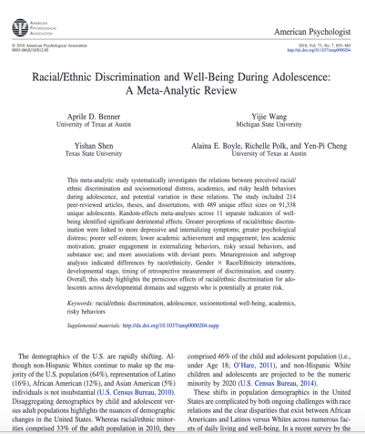
Harms of Racism & Xenophobia
Depressive/internalizing symptoms
Positive well-being, self-esteem
Acad. achievement, engagement, motivation
Externalizing behaviors, risky sexual behaviors, substance use
Benner et al., 2018; Yip et al., 2019
Youth
Family
Educators
Assets
Problem

Slide 28

Trent, Dooley, & Dougé 2019
Youth
Family
Educators
Assets
Problem

Slide 29
Advancing Justice
Naming the Problem
Identifying Community Assets
Learning from Youth
Learning from Families
Learning from Educators
Cultural
Civic/Political

Slide 30
Racism, Prejudice,
Discrimination,
Oppression
Symbolic and structural racism
Racial inequities
Adaptive culture
Cultural/racial competencies
COMMUNITIES
FAMILIES
YOUTH
Net vulnerability via balance of ethnic-racial risk and protective factors
Assets:
Identity, Coping,
Challenge (Civic/political)
Coll et al., 1996, 2016; Spencer, 1995, 2007
Youth
Family
Educators
Assets
Problem

Slide 31
Assets: Ethnic-Racial Positive Affect/Regard as Promotive
Domain | Outcome | k | r | p | N
Psychosocial | Anxiety | 6 | -0.04 | .07 | 1,698
 | Depressive symptoms | 12 | -0.30 | .001 | 2,373
 | Externalizing problems | 7 | -0.15 | .01 | 1,928
 | Internalizing problems | 4 | -0.11 | .05 | 1,573
 | Positive social functioning | 6 | 0.37 | .01 | 1,246
 | Self-esteem | 21 | 0.23 | .001 | 4,083
 | Well-being | 8 | 0.20 | .05 | 2,530
Academic | Academic achievement | 13 | 0.17 | .001 | 4,593
 | Academic/school attitudes | 19 | 0.17 | .001 | 6,464
Risk-Related | Risk behaviors/attitudes | 10 | -0.26 | .01 | 1,518
Mean age: 14.3
Rivas-Drake et al., 2014
Youth
Family
Educators
Assets
Problem

Slide 32
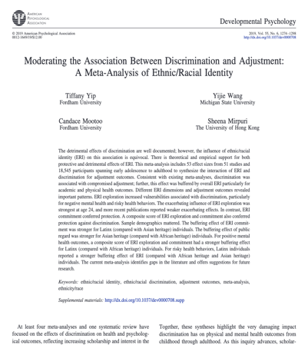
Assets: Ethnic-Racial Identity as Protective
ERI
Buffering?
Discrimination
Adjustment
It depends…
Exploration, Regard: No Commitment: Yes
Yip et al., 2019
Youth
Family
Educators
Assets
Problem

Slide 33
Advancing Justice
Naming the Problem
Identifying Community Assets
Learning from Youth
Learning from Families
Learning from Educators
Identity x Political Understandings

Slide 34
YOUTH Meaning-Making
What does your ethnicity mean to you? How has this changed in the past year?

Slide 35
I am proud to be Mexican even if White people (some, not all) might think we are [not] as smart or as equal to them. I love my ethnicity. I love the foods, culture, people…Some White people out there want us to go back to our country. (I guess they haven't tried our food.) I am proud of my ethnicity and I wouldn't change. It is the best.
PUBLIC REGARD
Youth
Family
Educators
Assets
Problem

Slide 36
I am proud to be Mexican even if White people (some, not all) might think we are [not] as smart or as equal to them. I love my ethnicity. I love the foods, culture, people…Some White people out there want us to go back to our country. (I guess they haven't tried our food.) I am proud of my ethnicity and I wouldn't change. It is the best.
PRIVATE REGARD AS RESISTANCE
Youth
Family
Educators
Assets
Problem

Slide 37
To me ethnicity means that I have an amazing history and that the family members, traditions, music, and other people that surround me have something to show me...Being Latina also means that during these controversial times I must pay close attention to what is occurring politically, as it will affect both me and others...
The past year has made me come to a realization that the way people view my ethnic group is usually negative…due to many political problems with race…I now have a stronger belief to represent my ethnic group and be proud more than ever.
The news has sort of made me feel stronger about my ethnicity because I feel like I have to defend what I am.
Trump and the government want us out of our country.
Nothing really happened…Except for Donald Trump calling Mexicans rapists, drug lords, and troublemakers...
Miller-Tejada, Camacho et al., in prep
Youth
Family
Educators
Assets
Problem

Slide 38
Advancing Justice
Naming the Problem
Identifying
Community Assets
Learning from Youth
Learning from Families
Learning from Educators
Cultural & Political
Lessons at Home

Slide 39
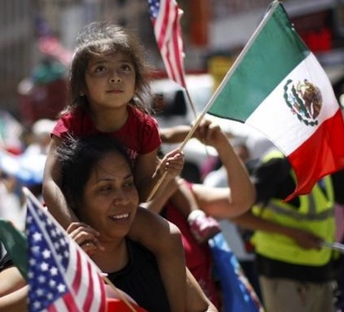
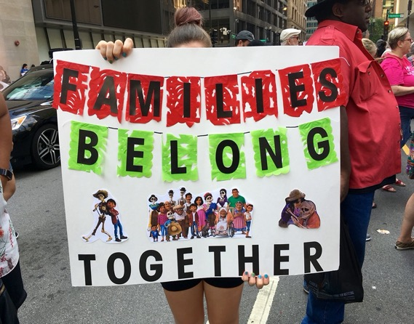
Learning from FAMILIES
How lessons about identity intersect with those about sociopolitical context?

Slide 40
Talking About Sociopolitical Context
I noticed it was important that they understood everything I talked to them about when they were younger because…in school they talk to their friends about their fathers being undocumented or having been deported and they start to get curious. I tell them how the situation is, so they don’t start creating their own conclusions.
Cross et al., 2020; Cross, Blanco Martinez, & Rivas-Drake, under review
Youth
Family
Educators
Assets
Problem

Slide 41
Talking About Sociopolitical Context
She understands now, because every time we’ve heard news of someone who was taken, she comes, and she tells me, "Mommy, I have a friend, he told me his parents told him that so-and-so was taken away, that someone was taken." Yes, she saw it on the news…
Cross et al., 2020; Cross, Blanco Martinez, & Rivas-Drake, under review
Youth
Family
Educators
Assets
Problem

Slide 42

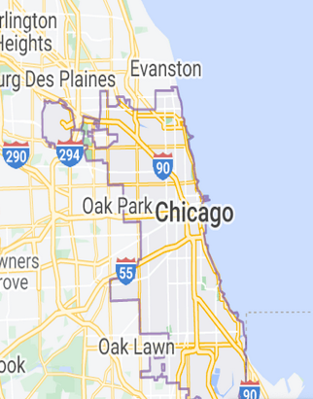
% Latinx Youth Said Their Families…
Youth
Family
Educators
Assets
Problem

Slide 43
Ethnic-Racial Socialization, Sociopolitical Discussions, and Latinx Youths’ Emergent Civic Development
Sociopolitical Discussions
“Talk about problems facing our community”
Cultural Socialization
“Said it is important to know about the important people and events”
Preparation for Bias
“Some people may treat you badly or unfairly”
Pinetta et al., 2020
Youth
Family
Educators
Assets
Problem

Slide 44
Ethnic-Racial Socialization, Sociopolitical Discussions, and Latinx Youths’ Emergent Civic Development
Sociopolitical Discussions
+
Civic Accountability
+
+
Cultural Socialization
+
Expectations for Future Community Involvement
+
+
ERI Exploration
+
Preparation for Bias
Full model info: CFI = .932, SRMR= .065, RMSEA = 0.09.
Pinetta et al., 2020
Youth
Family
Educators
Assets
Problem

Slide 45
Advancing Justice
Naming the Problem
Identifying Community Assets
Learning from Youth
Learning from Families
Learning from Educators
Leveraging Assets
Youth
Family
Educators
Assets
Problem

Slide 46
Learning from
EDUCATORS

Slide 47
Centering Youths’ Lived Experiences and Identities
I chose this book because it is a collection of short stories about the lives of Latino youth growing up in the U.S., and I hope you can relate to some of the characters in the stories.
McGovern, Rosario-Ramos, Rivas-Drake, Pinetta, Montoro, & Channey, in prep
Youth
Family
Educators
Assets
Problem

Slide 48
Validating Youths’ Experiences of Oppression
Fears: ICE raids in the community, deportation, being pulled over by the police
There are so many other people living through similar things and almost everyone knows that people are struggling with these kinds of issues, but no one ever talks about them. We know all of these things are happening but we don’t talk to them. We don’t check up on people, and we learn and read stories but we read it and that’s it. We don’t talk about it.
McGovern, Rosario-Ramos, Rivas-Drake, Pinetta, Montoro, & Channey, in prep
Youth
Family
Educators
Assets
Problem

Slide 49
Encouraging Youth To Use Their Voice
You have a powerful voice and need to let others know that you care...Todos ustedes son líderes. You are all leaders. And your voices have the power to enact change in your communities.
McGovern, Rosario-Ramos, Rivas-Drake, Pinetta, Montoro, & Channey, in prep
Youth
Family
Educators
Assets
Problem

Slide 50
Advancing Justice
Naming the Problem
Identifying Community Assets
Learning from Youth
Learning from Families
Learning from Educators

Slide 51
Connection
Consciousness
Learn by
Exposure
Learn to
Respond
Self
Vicarious
Institutional
Societal (Media)
Awareness
Coping
Resisting
Solidarity
Identity
Family – School – Community – Peers
Evade/avoid? Rationalize?
Affirm? Clarify? Warn?
Strategies? Tools? Models?
e.g., Ginwright, 2010, 2016; Mathews et al., 2020; Rivas-Drake & Juang, in prep
Notes:
The question

Slide 52





With Gratitude To…
CASA Lab
Schools, families, and youth
Collaborators
Funders
Land

Slide 53

Thank You
Deborah Rivas-Drake, Ph.D.
drivas@umich.edu
@DrRivasDrake

Slide 55
Anti-Black, NA/AN, Latinx, and Asian/PI Hate Crimes
Source: https://www.fbi.gov/services/cjis/ucr/hate-crime (Table 1; 2004-2019)
Youth
Family
Educators
Assets
Problem

Slide 56
Ethnic-Racial Identity among Latinx High School Youth
Describes Me Well
Describes Me A Little
Time 1
Time 2
Time 3
Constante, Cross, Medina, & Rivas-Drake, 2020
Youth
Family
Educators
Assets
Problem

Slide 57
Trends in Ethnic-Racial Identity Over Time
Describes Me Very Well
Describes Me Well
Describes Me A Little

Slide 58
Assets: Coping with Ethnic-Racial Discrimination
+
Being proud of who you are
Peer Discrimination
+
+
Working to disprove stereotypes
Adult Discrimination
Say something right back
Full model info: CFI = .92, SRMR= .06, RMSEA = 0.04.
Montoro et al., 2020
Youth
Family
Educators
Assets
Problem

Slide 59
Ever Exposed to Discrimination (2018)
Perpetrated by Adults in Community
Perpetrated by Peers in School

Slide 60
Ever Exposed to Discrimination (2018)
Similar in community and among peers – no reprieve
Perpetrated by Adults in Community
Perpetrated by Peers in School

Slide 61
Ever Exposed to Discrimination (2018)
Similar in community and among peers – little reprieve
Perpetrated by Adults in Community
Perpetrated by Peers in School

Slide 62
Ever Exposed to Discrimination (2018)
Primarily in community – somewhat less so among peers
Perpetrated by Adults in Community
Perpetrated by Peers in School

Slide 63
Peer, School, and Societal Discrimination
among Black Youth (Ever Happened)
A few times
Once or Twice
Never
Time 1
Time 2
Time 3
Hoffman et al., in prep
Notes:
N=742

Slide 64
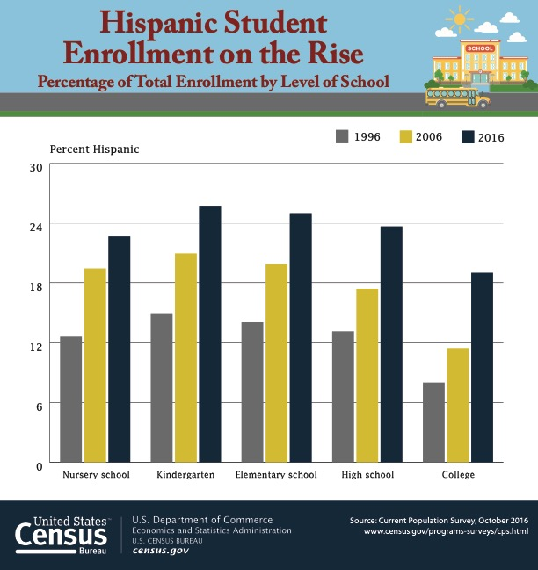
https://www.census.gov/library/visualizations/2017/comm/hispanic-school.html

Slide 65

Peers are Important Sources of Knowledge
about Group Status
Figure out who they are and where they belong
Socialization of norms re: ingroup vs. outgroups
More general peer norms around ethnicity/race
Santos, Kornienko, & Rivas-Drake, 2017
Notes:
Peer processes
Influence becomes more prominent in adolescence
Important for a wide range of issues¹
Figuring out who they are where belong
Often, understandings of E/R are constructed and reinforced among peers
Ethnographic accounts²
Experimental studies - Having intergroup contact at a racially heterogeneous school predicted lower ingroup bias in ratings of a hypothetical transgressor³
Correlational – Perceived peer attitudes toward outgroups predicted own attitudes toward outgroups⁴

Slide 66
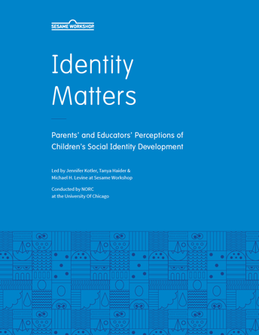
Racism and Xenophobia Are REAL…
1 in 4
Parents reported their child had heard a negative comment about their
race or ethnicity

Slide 67
Racism and Xenophobia Are REAL…
1 in 6
Parents reported their child had heard a negative comment about their
country of origin

Slide 68
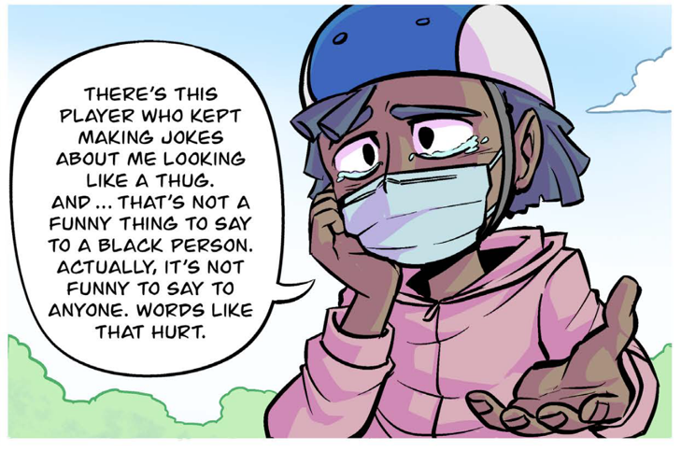
Peer-to-Peer Racism Is a Problem, Too
Used with permission from Committee for Children
e.g., Douglass et al., 2016; Pollock, 2004; Tynes et al. 2019

Slide 69
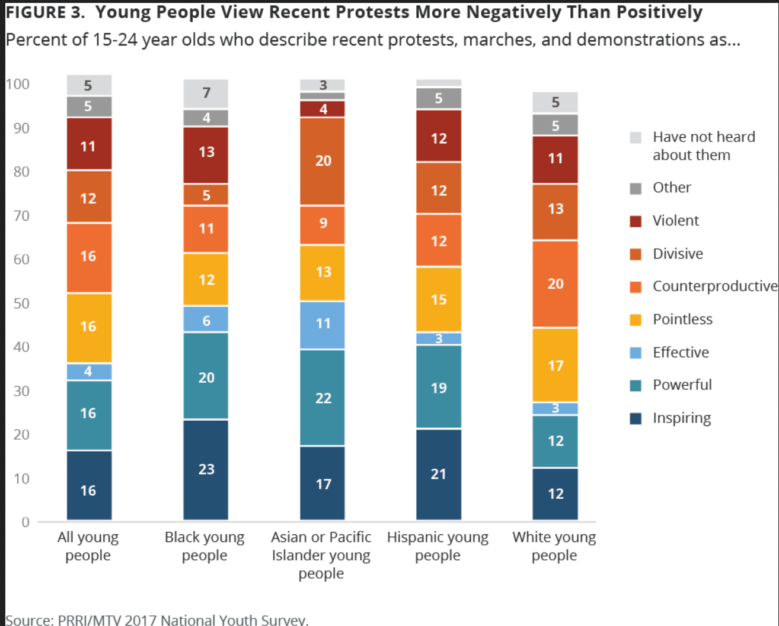

49%
50%
43%
27%
Source: https://www.prri.org/research/mtv-culture-and-religion/
Notes:
I find it very hopeful that the 2018 MTV/PRRI report I mentioned earlier shows that large proportions of Black, Asian American or Pacific Islander, and Latinx 15-24 year olds viewed recent protests, marches, and demonstrations as EFFECTIVE, POWERFUL, OR INSPIRING. [CLICK]

Slide 70
Centering Youths’ Lived Experiences and Identities
Coronavirus?
How did you know I was going to present that story as the news of the day today?
McGovern, Rosario-Ramos, Rivas-Drake, Pinetta, Montoro, & Channey, in prep
Youth
Family
Educators
Assets
Problem

Slide 71
Centering Youths’ Lived Experiences and Identities
“There are times that we do have to step away from the curriculum to input things…so that students can really benefit and they see the direct connection…This just happened and this is important. This is what makes sense right now. Especially things on the news, things in our local community. We had a lockdown drill last year that lasted a long time and we thought it was a drill but...It was a lockdown. They had said that there might have been somebody at [a community site] with a gun, and so as I'm in the closet with my students and time kept passing and passing and passing, I started to get really nervous thinking about is somebody going to come into our school, where it became real…so we stepped away the next morning and we talked about our lockdown and we talked about emotions that we were having, and things like that because students need to debrief.”
McGovern, Rosario-Ramos, Rivas-Drake, Pinetta, Montoro, & Channey, in prep
Youth
Family
Educators
Assets
Problem

Slide 72
Encouraging Youth To Use Their Voice
Adults don’t take youth seriously
Although people often overlook your voices because of your young age, your voices are important…I encourage you to get involved with the student voice committee because your voices have the power to change the mentality of teachers, students, and leaders.
McGovern, Rosario-Ramos, Rivas-Drake, Pinetta, Montoro, & Channey, in prep
Youth
Family
Educators
Assets
Problem

Slide 73
Talking About Sociopolitical Context
We do know people who are undocumented. And we have to talk to them about it, but sometimes we find out about what happened to a person who got caught by immigration, or classmates of my daughter who was in the school over there, so you always hear those kinds of things.
Cross et al., 2020; Cross, Blanco Martinez, & Rivas-Drake, under review
Youth
Family
Educators
Assets
Problem

Slide 74
Ethnic-Racial Identity among Black & Latinx
Middle Schoolers
Community and civic orientations
Describes Me Well
Describes Me A Little
Time 1
Time 2
Time 3
Time 4
Bañales, Hoffman, Rivas-Drake, & Jagers, 2020
Youth
Family
Educators
Assets
Problem

Slide 75
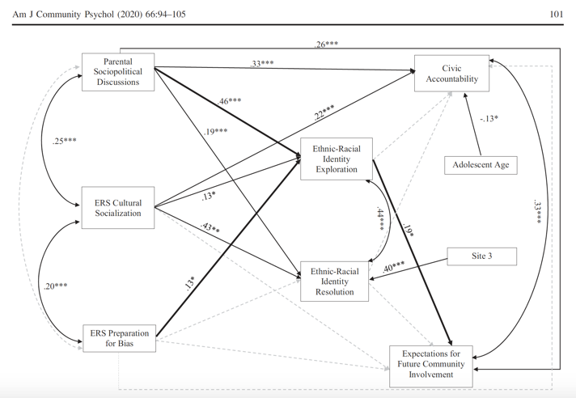
Ethnic-Racial Socialization, Sociopolitical Discussions, and Latinx Youth Emergent Civic Development
Pinetta et al., 2020
Youth
Family
Educators
Assets
Problem

