Slide 1
The Long-Term Effects of the COVID-19 Pandemic on Children and Families

Slide 2
Study Sponsors
Administration for Children and Families, U.S. Department of Health and Human Services
Robert Wood Johnson Foundation
Notes:
Before we get started, I want to recognize our sponsors whose generous support made this important work possible. Thank you to the Administration for Children and Families, a division of the U.S. Department of Health and Human Services, and the Robert Wood Johnson Foundation for their investment in this work.

Slide 3
Committee
Tumaini Rucker Coker (Chair)
University of Washington, Seattle Children’s
Tina L. Cheng
Cincinnati Children’s Hospital, University of Cincinnati
Joshua Goodman
Boston University
Nia Jenee Heard-Garris
Northwestern University
Stephanie M. Jones
Harvard University
Velma McBride Murry
Vanderbilt University
Cyril “Kent” McGuire
William and Flora Hewlett Foundation
Robert S. Pynoos
University of California, Los Angeles
Michelle Sarche
University of Colorado Anschutz Medical Campus
Florencia Torche
Stanford University
Joseph L. Wright
Harvard University
Marci Ybarra
University of Wisconsin
Alejandra Casillas (NAM Scholar)
University of California, Los Angeles
Staff: Jennifer Appleton Gootman, Adam Jones, Sunia Young, Emily P. Backes, Natacha Blain
Notes:
Our 12-member committee brought great diversity in terms of discipline, expertise, and perspectives with scholars from economics, developmental psychology, education and early learning, equity, health and medicine. Our committee was also supported by the National Academies’ Board on Children, Youth, and Families staff, under the leadership of study director Jennifer Gootman.

Slide 4
Statement of Task
1. What policies and programs are needed to address the developmental, emotional, behavioral, and physical health needs of children in high-risk communities to promote child health and well-being in the long-term?
3. What policies and practices can work to address disparities and inequities experienced by communities of color following a pandemic?
2. What was learned during the pandemic about promising practices to support parent and caregiver well-being?
Notes:
Our committee began its work in the fall of 2021, just a year and a half into the pandemic. Over the last 18 months, we have met to review and examine the evidence on three broad questions:
What policies and programs are needed to address the developmental, emotional, behavioral, and physical health needs of children in high-risk communities to promote child health and well-being in the long-term?
What was learned during the pandemic about promising practices to support parent and caregiver well-being?
And, what policies and practices can work to address disparities and inequities experienced by communities of color following a pandemic?

Slide 5
Study Context
Over 6.5 million deaths from COVID-19 globally, with over 1 million in the U.S. alone
Over 15 million children have tested positive, thousands have been hospitalized, and more than 2,100 have died.
The magnitude and mortality of this pandemic exceeds even that of large-scale natural disasters
Notes:
To place this consensus study in context, it is important to highlight the pandemic’s scope and scale.
COVID-19 has resulted in imminent danger, severe illness, and death.
As of January 2023, it has been the cause of over 6.5 million deaths worldwide, with over 1 million of them in the United States alone.
Over 15 million children have tested positive for COVID-19, thousands have been hospitalized, and more than 2,100 children have died.
Collectively, we have all experienced the largest pandemic in the history of the United States. The magnitude and mortality of this pandemic, exceeds even that of large-scale natural disasters and portends the risk of negative consequences across health and wellness outcomes, for children and their families for decades to come

Slide 6
Pandemic Disproportionately Affected Black, Latino, Native American Youth and Families

Slide 7
Population Focus
Defining “High Risk”
Defined “high risk” as those most disproportionately impacted: Black, Latino, Native American, and low-income
Age Focus
Children as primarily birth through age 18, with additional focus on 18-24 in some areas
Notes:
In our statement of task by the study’s sponsors, our committee was asked to focus on children and families in “high-risk communities.”
Informed by conversations with the sponsors and data on the disproportionate impact of the COVID-19 pandemic on certain populations, our committee defined “high-risk communities” as encompassing children and families who are Black, Latino, and Native American and those with low incomes.
The report primarily defined “children” as birth to 18, with an added focus on young adults ages 18-24, in certain situations, for example, when discussing matriculation to postsecondary education.

Slide 8
Study Methods
Literature Review
Wide range of disciplines, including social and behavioral sciences, health and medicine, education, economics, policy, and disasters
Listening Sessions
Adolescents
Early care & education professionals
K12 educators & administrators
Juvenile justice & child welfare professionals
Native American community leaders
Frameworks
Lifecourse perspective
Framework of danger, safety, protection
Pandemic “signatures” and dose of exposure
Notes:
To carry out its work, our committee gathered in three virtual and two in-person meetings and conducted additional deliberations by video conference and electronic communications.
Our committee also organized a wide range of information-gathering activities, including:
An extensive critical review of the existing research literature in a wide range of disciplines, including the social and behavioral sciences, health and medicine, education, economics, policy, and disasters.
In addition to deliberating on the available scientific literature and evolving information related to the pandemic, we held a series of Listening Sessions. These were information-gathering sessions with key groups of stakeholders, including adolescents, early care and education professionals, K-12 educators and administrators, juvenile justice and child welfare professionals, and child development leaders from tribal communities. These sessions provided important context for understanding how these groups experienced the pandemic.
Finally, we used several frameworks to guide our work.
We relied on the Lifecourse Perspective, which situates human development in individual, societal, and global historical context. This perspective is premised on the idea that the impact of specific events and experiences on developmental outcomes can only be understood with socio-cultural, geographic, and historical context in mind, and that individual outcomes and pathways represent the sum of experiences in context, over time, and across generations.
We used the Framework of Danger, Safety and Protection which recognizes that individuals experience not only specific mental health conditions such as anxiety or depression, but also a wide range of psychological, behavioral, developmental, and societal responses to danger.
And finally, from the vast disaster literature, there are two major elements that play a role in the long-term outcomes of a disaster event: first, the signature of the event; and second, the dose of exposure for a child and their family. The signature of the event includes objective measure of the type and magnitude of the event itself, and the dose of exposure, focuses on how that event affected the individual or family.
Throughout the Committee’s deliberations, evidence about the impact of the pandemic on children and families began to emerge as more and new data became available through local-, state-, and national-level studies. While the evidence continues to emerge and evolve as longitudinal data are being collected, the committee’s report reflects its understanding of the impact of the pandemic on children and families through early 2023. Additional information about the long-term effects of the pandemic will continue to emerge in the years to come.

Slide 9
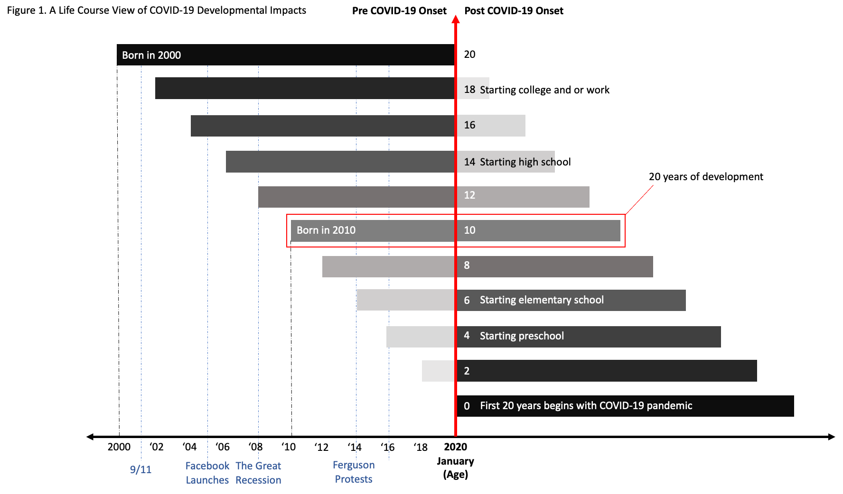
Notes:
The full characterization of the pandemic effects needs be examined from a life course perspective because its three fundamental characteristics:
It is developmental, that is, shaped by individual and societal experiences prior to the pandemic as well as the salient developmental windows and tasks at play at its onset and throughout;
It is ecological, that is, situated in a sociodemographic, familial, community, societal, historical, and cultural context;
And it is variable in its effects and consequences for racially and ethnically minoritized families and communities.
The committee created this visual of the life-course perspective in 20-year age cohorts, oriented around January 2020, and anchored in birth years beginning in the year 2000. The figure focuses at the individual level, where time is represented by ages, life stages, and ecologically salient developmental tasks – such as the start of elementary school or high school.
By way of simple example, the behavioral and educational effects of school disruptions for a child just beginning formal schooling are quite different from the effects for a child beginning the 4th grade who already has school routines, early reading, and other key skills under their belt.

Slide 10
Societal Context of the Pandemic
Structural Racism
Failures of U.S. Treaty Obligations to Native Communities
Pre-Pandemic Inequities
Income Inequality
Child Mental Health Crisis
Protests for Racial Justice
Disinformation & Political Division
Notes:
Disasters or large-scale public health events like the COVID-19 pandemic can highlight, and in some cases, exacerbate preexisting vulnerabilities resulting from long-standing societal inequities. We know that the societal shock of the COVID-19 pandemic did not occur in a vacuum, but rather within a larger social context of inequity, with stark consequences for minoritized and low-income children.
We start in a context of structural racism which refers to a system in which historical and contemporary public policies, institutional practices, cultural representations, and other norms work in different, often reinforcing ways, to maintain or compound racial and socioeconomic inequalities. The COVID-19 pandemic landed in this inequitable environment, and context, which includes:
Failures of U.S. Treaty Obligations to Native Communities;
Pre-pandemic inequities in social, emotional, behavioral, educational, mental, physical, and economic health and well-being;
Income inequalities;
And an existing child mental health crisis.
The pandemic also intersected with other major social events, including the widespread protests for racial justice in 2020, and increasing disinformation and political division in public discourse.

Slide 11
COVID 19 was the GREAT REVEALER
of pre-existing vulnerabilities of longstanding societal inequities: that is, the societal shock of the COVID-19 pandemic did not occur in a vacuum or a neutral environment
The pandemic landed in an inequitable socio-political environment

Slide 12
Short Term Pandemic Experiences
Imminent danger
Unknown threat of severe illness and death
Social control to prevent disease spread
Disruptions in everyday life, including home, school, work, businesses, worship, and access to health care service delivery

Slide 14
Immediate Effects of the Pandemic on Children and Families
Social & Emotional Development
Education
Mental Health
Physical Health
Notes:
The COVID-19 pandemic has had an unprecedented impact on the lives of children and their families, who have been confronted with innumerate challenges, including illness and death; public health safety measures, such as school closures; social isolation; financial hardship; food insecurity; mental health effects; and lack of or gaps in access to health care.
While some effects of these stressors were immediate, some may not become apparent until later in their lives.
Overall, the developmental trajectories of children have been disrupted, which could have long-lasting effects on social emotional, educational, economic, and health outcomes.

Slide 15
Immediate Effects: Social and Emotional Development
Increases in children’s dysregulated, internalizing, and externalizing behaviors
Decreases in children’s adaptive behaviors and self-regulation skills
Increases in parents’ stress, household chaos, challenges in parents’ mental health, and parent–child conflict
Increases among adolescents and young adults in concern about their present and future, time spent feeling unhappy or depressed, lack of social connection
ATTRIBUTION CAN BE SEVERAL LINES IF NEEDED

Slide 16
“Social emotional impacts have come out in their play, especially in kids from families that were already in tight situations and who then were quarantined together. In addition to using language that their parents might use, they would also often emulate the more teenage language and behaviors in their favorite shows. So we would need to redirect that kind of play and provide context for them to help understand media they encountered at home when their parents were dealing with the stressors of the pandemic and weren’t always able to explain what they watched. ”
Listening Sessions with Early Childhood Teachers

Slide 17
“More and more of the focus has been on teaching students about how to be in school again—simple things like raising hands when asking questions rather than shouting out answers or letting fellow students talk without interrupting them—all things that students have struggled with since returning to in-person instruction.”
“Homeroom class became more about providing social and emotional learning and development with students because they needed a space where they could receive the mental health support.”
“One strategy that we found effective was creating small cohorts of
students in our homeroom classes where they could practice interacting with each other again.”
Listening Sessions with Teachers
Notes:
English learners

Slide 18
Immediate Outcomes: Education
Declines in Early Childhood Program Enrollments
Programs serving minoritized, low-income and language other than English families had highest enrollment loss
Declines in K-12 Enrollment
Largest declines in Kindergarten (9%); Districts have not recovered
Decreased Engagement
72% of public schools reported higher rates of chronic absenteeism
Missed Learning
Early childhood, K-12
Greatest among children without in-person schooling
Kindergartner scoring well below benchmark in early literacy: greatest increase for Black (27% to 54%) and Latino children (34% to 59%)
Declines in College Enrollment
Worse for community college enrollment: 20% lower in 2021 compared to 2019
Public four-year down 10%; worse for Native American students

Slide 19
“Students were exposed to difficult situations at home, from adults’ stress about finances or illnesses in the family, to older siblings struggling to navigate learning alongside them.”
“They often carried that stress back to school, requiring teachers to create space for difficult conversations in addition to their lesson plans."
“In addition, technology and social media exposed kids to new behaviors and new ideas that they carried to school and often lacked context and needed explaining.”
Listening Sessions with Teachers

Slide 20
Velma’s Slides Start Here

Slide 21
Immediate Effects of the Pandemic on Children and Families
Social & Emotional Development
Education
Mental Health
Physical Health
Notes:
The COVID-19 pandemic has had an unprecedented impact on the lives of children and their families, who have been confronted with innumerate challenges, including illness and death; public health safety measures, such as school closures; social isolation; financial hardship; food insecurity; mental health effects; and lack of or gaps in access to health care.
While some effects of these stressors were immediate, some may not become apparent until later in their lives.
Overall, the developmental trajectories of children have been disrupted, which could have long-lasting effects on social emotional, educational, economic, and health outcomes.

Slide 22
While rates of COVID-19 infections were low, and less than 5% deaths were of children: ¾ of COVID-19 hospitalizations of children were among those younger than 4 years of age or older than 12
COVID-19 infection has been associated with increased risk for multisystem inflammatory syndrome among affected children
1,813 children infected
4.5% had symptoms longer than 4 weeks
3% symptoms longer than 12 weeks
Symptoms were 3X longer for unvaccinated children
Notes:
MIS-C is a rare and serious condition with long term pathophysiological consequences, which are not well understood by may have implications children’s well being over time.
Vaccines for young children, two years after the outbreak of the pandemic

Slide 23
Vaccination Patterns and Barriers
Vaccines among children were relatively low, initially, but 43% had received at least one dose by January 2023
Low rates appear to be associated with vaccine hesitancy
Vaccination rates among US children are generally low, with the exception of Asian children
General patterns of vaccination:
73.4% Asian children
49% Latino children
45% White children
44.7% Black children
Strong predictors of vaccinations:
Poverty
Political leaning of county where children reside
Having unvaccinated parents and parents’ hesitancy

Slide 24
Racial/Ethnic Variability in COVID-19 Health Consequences
Black, Latino and Native American children were disproportionately impacted by COVID-19:
infections
hospitalizations
deaths
Even when vaccine treatment was approved for children, those from racially and ethnically minoritized groups had less access to treatment

Slide 25
Long-Term Effects of COVID-19 on Maternal/Child Health
Maternal mortality rate increased by 33%, with higher increases for Black and Latina women compared to White women
Low rates among babies born to mothers with infections
Short-term effects on mothers and infants are under investigation, however, the “Fetal origins hypothesis” posits that insults during key developmental periods of development can generate a wide set of effectives over the life course.

Slide 26
Long-Term Effects of COVID-19 Illness
1,813 children infected
4.5% had symptoms longer than 4 weeks
3% symptoms longer than 12 weeks
Symptoms were 3X longer for unvaccinated children
Little is known about prevalence of LTE on children
Elevated patterns of onset of type 1 and type 2 diabetes and clusters of hepatitis were observed among children infected but unclear if associated with COVID19
Need to track outcomes of cohorts of children who have been exposed in utero and during early childhood.

Slide 27
Other Consequences
Food Insecurity
Safety net disappeared when schools closed
Decrease Access to Health Care
Limited support for children with developmental disabilities and special needs for care
Services were shut down, loss of access to therapy, health care, and education services

Slide 28
Immediate Effects of the Pandemic on Children and Families
Social & Emotional Development
Education
Mental Health
Physical Health
Notes:
The COVID-19 pandemic has had an unprecedented impact on the lives of children and their families, who have been confronted with innumerate challenges, including illness and death; public health safety measures, such as school closures; social isolation; financial hardship; food insecurity; mental health effects; and lack of or gaps in access to health care.
While some effects of these stressors were immediate, some may not become apparent until later in their lives.
Overall, the developmental trajectories of children have been disrupted, which could have long-lasting effects on social emotional, educational, economic, and health outcomes.

Slide 29
Shelter-at-Home Vulnerability
Increased risk of harm, especially in highly stressed households
Child-Help National Child Abuse Hotline calls increased by 20% first months of the pandemic
Notes:
English learners

Slide 30
“Children would come back and say they hadn’t seen their grandparents in a while, but when you talked to their families, you’d learn that their grandparents may have passed away. They didn’t know the depths of everything going on, but you could see the social emotional responses of them being withdrawn or being upset, so we could tell that they could feel the effects of things, but not necessarily explain them. It became our jobs to say, for example, you seem like you’ve been kicking toys around a lot today, how are you feeling inside? A major focus of our time became giving them an outlet to be able to express things they don’t know how to express yet.”
Listening Participant, Teacher

Slide 31
265,000 Bereaved Children
Native American Children
1 in 168
Black Children
1 in 310
Latino Children
1 in 412
White Children
1 in 753

Slide 32
Symptoms in children
Worry
Insomnia
Irritability
Depression (sadness, guilt, fatigue, change in sleep and appetite)
Children were constantly reminded of the devastation of COVID-19, causing:
Increase awareness of illness and potential death
Fear and perceived threat
Physical and social distancing from loved ones, friends, and school

Slide 33
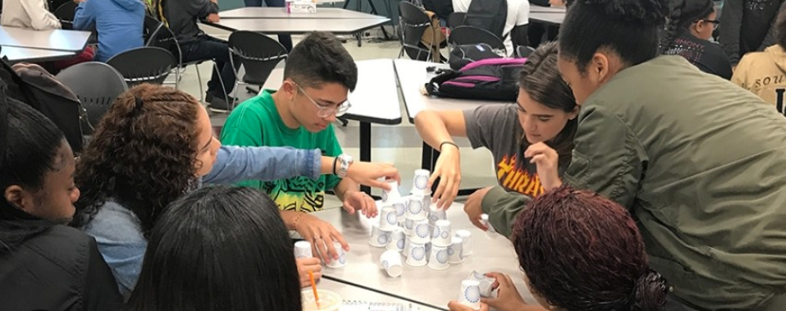
“The initial response from kids being able to come back in person was of just being happy to be out and among their friends again. The sadness came out when they talked about not having a chance to see their family members in a while. They knew exactly how long it had been—whether days or months.”
Listening Session Participant,
Teacher

Slide 34
Pandemic Barriers to Health and Well-Being
COVID-19 has had major direct effect on children’s physical health, mental health, and exposure to violence, suggesting the need for research documentation and public health measures to reduce the LTE effects on them as they continue to grow and develop.
Notes:
English learners

Slide 35
Address immediate effects
Mitigate potential shifts in the life course trajectories
Recommendations
A Path to Recovery & Programs and Policies to Rectify Inequities
Collect & respond to comprehensive child- and family-focused data
Prepare for the next pandemic
Notes:
Without targeted investments in programs, services, supports, and interventions to counteract the pandemic’s direct and indirect negative impact on child and family well-being, the pandemic’s impacts are likely to be long lasting, with negative effects not only on children and families, but also on society at large.
In order to create a path forward to recover from the harms of the pandemic and support programs and policies to rectify the inequities that have made the pandemic’s impact disproportionate, the committee’s recommendations focus on 4 areas:
Addressing the immediate and short-term direct and indirect effects of the pandemic on children and their families;
Mitigating potential shifts in the life-course trajectory of children and families due to the pandemic;
Collecting and quickly responding to comprehensive, child- and family-focused data to help understand the pandemic’s ongoing effects on children and families;
And preparing for the next pandemic.
Before turning things over to Michelle who is going to share the Committee’s specific recommendations for addressing these areas, I wanted to share some recommendations we heard from teens themselves who participated in a listening sessions in Chicago.

Slide 36
Recommendation from Teens
Participants pointed to after school programs and job opportunities as helpful in establishing routines and supporting their physical and mental health but emphasized that these opportunities are limited in many communities..
Listening Session with Group of Teens in Chicago

Slide 37
Recommendation from Teens
Participants expressed experiencing feeling isolated. They noted that they lacked the emotional support that they had previously had at school through relationships with counselors and engagement in extracurricular activities. They expressed a need for additional mental health resources and a more robust social and emotional safety net at school.
Listening Session with Group of Teens in Chicago

Slide 38
Recommendation from Teens
“To make things better for me and my family and other young people affected by the pandemic, the government [should] promote mental health resources—a lot of teenagers are struggling mentally, and a lot of people don’t know it. It’s something that needs to be addressed not later, but now”
Listening Session Participant, Group of Teens in Chicago

Slide 39
Michelle’s Slides Start Here

Slide 40
Prioritize Youth and Families
Recommendation 1: The secretaries of the U.S. Department of Health and Human Services and the U.S. Department of Education, in coordination with the Domestic Policy Council, the Office of Management and Budget, states, Native American tribes, localities, and the nonprofit and private sectors, should establish a task force on addressing the effects of the COVID-19 pandemic on children and their families, with a focus on those who have experienced the greatest negative burdens of the pandemic: Black, Latino, and Native American children and families and those with low incomes.
Notes:
As Velma shared, the Committee’s recommendations were designed to create a pathway to recovery and to rectify the underlying inequities that contributed to the pandemic’s disproportionate impact. The Committee came up with 10 recommendations and I’m going to walk through them briefly now.
The first set of recommendations aim to ensure that the needs of children and families are prioritized in our ongoing pandemic and post-pandemic response. The Committee recommends that federal, state, tribal and local governments as well as nonprofits and the private sector create a task force for addressing the ongoing effects of the pandemic on children and families, particularly those that have experienced the greatest burden…

Slide 41
Prioritize Youth and Families
Recommendation 2: All federal and state agencies and departments involved in COVID-19 pandemic relief planning and future public health disasters should address the needs of pregnant people, and children, and low-income and racially and ethnically minoritized populations, including children and adolescents in the foster care and juvenile justice systems, in the planning and management of public health disaster relief and recovery efforts.
Notes:
and that in pandemic management and preparedness planning, government agencies and departments, at all levels – federal, state, tribal – pay particular attention to the needs of pregnant people, children, low-income and racially and ethnically minoritized populations, and children in foster care and the juvenile justice system.

Slide 42
Address Social, Emotional, and Educational Needs
Recommendation 3: The U.S. Department of Education should renew pandemic-related funding that allocates a greater proportion of funding to high-poverty schools to address:
Enrollment and re-engagement
Academic recovery and achievement
Recovery and optimization of positive social and emotional development
Support and expansion of the education workforce
Preparation for the next pandemic - “pandemic proofing”
Notes:
The next set of recommendations address the social, emotional and educational needs of children. Across all measures of school engagement, cognitive skills, and social and emotional health, students appear worse off than they would have been absent the pandemic, and such effects are generally more pronounced for low-income and racially and ethnically minoritized communities. The Committee therefore recommends that the US Department of Education renew pandemic-related funding that allocates a greater proportion of funding to high-poverty schools to address enrollment and re-engagement, academic recovery and achievement, social and emotional development, support for the education workforce, and planning for the next pandemic.

Slide 43
Address Physical and Mental Health Needs
\
Recommendation 4: The U.S. Department of Health and Human Services (HHS) should strengthen and expand Medicaid coverage at the federal level so that all children and families have consistent access to high-quality, continuous, and affordable physical and mental health services. This should include establishing and enforcing national standards for equitable payment rates, presumptive eligibility, multi-year continuous eligibility periods, and network adequacy.
Notes:
The next recommendations address the physical and mental health needs and families. While there have been important federal policies enacted to help address child and family physical and mental health needs, the Committee believes there is still much to do. Federal efforts to halt disenrollment from Medicaid during the public health emergency were critical to increased enrollment. Given that Medicaid will be important for ensuring that children and families experiencing low income have coverage to address the increased physical and mental health burdens they faced, the Committee recommends that HHS establish and enforce standards of care for Medicaid and the Children’s Health Insurance Program that include national standards for equitable payment rates, presumptive eligibility, continuous eligibility periods, and network adequacy.

Slide 44
Address Physical and Mental Health Needs
\
Recommendation 5: The U.S Department of Health and Human Services should increase investments in and advance policies and funding to ensure that youth and families can access high-quality treatment and preventive behavioral health services in clinical settings, communities, and schools.
Notes:
and that HHS increase investments in behavioral health care in particular by: advancing policies that ensure mental health parity; expanding Medicaid payments to include non-medical professionals for preventive and community-based behavioral health services; and, strengthening the behavioral health workforce through increased training in evidence-based behavioral health care, opportunities for racially and ethnically minoritized individuals to enter the child behavioral health workforce, and loan repayment programs for child behavioral health care professionals.

Slide 45
Address Economic Needs
Recommendation 6: The federal government should incentivize states to expand key safety-net programs, including Temporary Assistance for Needy Families, and childcare subsidies. The federal government should incentivize states to expand the number of families served in these safety net programs, raise the floor benefit levels states must provide in relevant programs, and reduce administrative burdens to facilitate program participation. These improvements should be coupled with rigorous evaluations of the effects of program expansion on family socioeconomic well-being, especially in states where safety net capacities are substantially enhanced.
Notes:
To address families’ economic needs, the Committee acknowledges the important role that federal-level interventions will play, particularly given widespread state-level variation in the type, amount, and duration of many of our safety net programs and access to social insurance provisions.
The Committee therefore recommends that the federal government incentivize states to expand key safety-net programs, such as Temporary Assistance for Needy Families, and child care subsidies – for example, by incentivizing states to expand the number of families served in these safety net programs, raise the floor benefit levels states must provide, and reduce administrative burdens to facilitate program participation.

Slide 46
Address Economic Needs
Recommendation 7: The federal government should support federal paid family leave and paid sick leave programs, building on similar pandemic-era and existing state-level programs. Alternatively, the federal government should incentivize states to implement their own paid leave programs.
Notes:
The Committee also recommends that the federal government support federal paid family leave and paid sick leave programs and/or incentivize states to implement their own paid leave programs. Given the evidence on the positive effects of paid leave on work attachment, family bonding, and maternal and child health, the Committee believes that implementing government-sponsored paid leave programs can provide much-needed support to all workers, particularly marginalized workers who are less likely to have employer-provided paid leave benefits.

Slide 47
Address Economic Needs
.
Recommendation 8: The federal government should reissue and continue pandemic-era expansion of the Child Tax Credit (CTC), as well as its distribution on a monthly rather than a yearly basis. In the absence of such expansion, state governments should consider implementing their own monthly CTC payments, as well as other provisions such as the Earned Income Tax Credit.
Notes:
Also, to address families’ economic needs, the Committee’s recommends that the federal government continue the pandemic-era expansion of the Child Tax Credit, including its distribution on a monthly rather than yearly basis - or, in the absence of such expansion, state governments should implement their own monthly Child Tax Credit payments.

Slide 48
Address Future Research and Data Needs
Recommendation 9: Public and private agencies, at the federal, state, and local levels, should eliminate existing barriers to and support mechanisms for child- and family-serving systems to collaborate on the systematic linking of data on children and families, across health, education, social services, juvenile justice, and child welfare systems with other federal and state administrative data, and to optimize and promote advancement in services, policy, programs, and research to address the negative effects of the pandemic on child and family well-being.
Notes:
The Committee’s last set of recommendations address future research and data needs. While evidence about the short-term effects of the pandemic on children and their families is beginning to emerge, the long-term effects remain unknown. In order to better understand the pandemic’s effects on life-course trajectories, significant investments to build a pandemic-focused research and data infrastructure are needed, including coordinating data collection and conducting urgent research.
To this end, the Committee recommends that public and private agencies, at the federal, state, and local levels, should eliminate existing barriers to and support mechanisms for child- and family-serving systems to collaborate on the systematic linking of data across health, education, social services, juvenile justice, and child welfare systems with other federal and state administrative data, and to optimize and promote advancement in services, policy, programs, and research to address the negative effects of the pandemic on child and family well-being.

Slide 49
Address Future Research and Data Needs
Recommendation 10: Relevant federal government departments and agencies should prioritize and fund rigorous research, and the infrastructure to support it, on the effects of the pandemic on children and families. Questions on COVID-19 exposure and adversity also should be incorporated into existing national studies, such as the Youth Risk Behavior Survey and the Head Start Family and Child Experiences Survey.
Notes:
The Committee also recommends that federal government departments and agencies prioritize and fund rigorous research on the effects of the pandemic on children and families and to ensure that COVID-19 exposure and adversity questions are incorporated into existing national studies, such as the Youth Risk Behavior Survey and the Head Start Family and Child Experiences Survey.

Slide 50
CONCLUSIONS
Without a focused strategy to change the altered life trajectory that the COVID- 19 pandemic has created for many children, a generation of young people will enter adulthood with worse mental health and a greater burden of chronic disease and impaired physical health as they age through adulthood. This is most pronounced for youth from minoritized and low- income communities.
Notes:
To conclude, the Committee believes that without focused strategies such as those outlined in the Committee’s recommendations - a generation of young people will enter adulthood with worse mental health and greater disease burden, and this will be most pronounced among youth from minoritized and low income communities.

Slide 51
A path forward to recover from the harms of the pandemic, address inequities, and prepare for future pandemics.
Notes:
The Committee’s recommendations call for targeted and sustained investments in programs, services, supports, and interventions that will
Help children and families continue to recover from the pandemic’s harms
Address the pre-existing inequities that made those harms worse for Black, Latino, and Native American families and those with low incomes
And prepare us for future pandemics.

Slide 52
“I want to forget this year, but I’m also afraid I won’t remember this year. I want this now to be the now where we save our place, your place, on earth.” ~ Tookie, in The Sentence, by Louise Erdrich
Notes:
And with that, I wanted to transition to our discussion with all of you. We welcome your questions, but also have questions for you - including,
How can we keep this work present and share information to multiple audiences?
How can we build a coordinated research effort that allows us to continue to learn from and document the experiences of children and families?

Slide 53
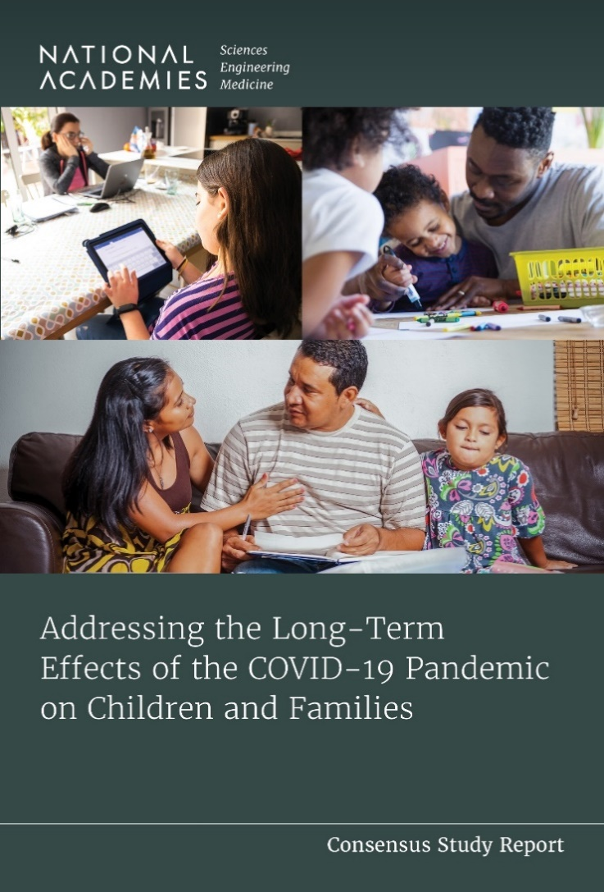
The report is available for free pdf download, at: www.nap.edu
For more information, please contact:
Jennifer Gootman, Study Director, jgootman@nas.edu

Slide 54
Extra Slides

Slide 55
For reference: Notes from today’s (Thursday) meeting - delete when done
Q and A
Velma – wrap up and transition to questions/dialogue
How might we share this more effectively to various populations – what kind of implementation plan should we give to NASEM. E.g. not talking directly to adolescents, targets feds.
What role might SRA play in process of addressing these issues
Bob – what adolescents do in response to difficulty – changes world to make it not happen again – want to engage in prosocial activities that address protective interventions. For future; addressing failure in the social contract
Stress adolescence in context
Getting information out
SRA’s role
Way they are thinking about usefulness of this report for own research or preventive interventions

Slide 56
Federal Response: Buffering Health and Economic Effects on Families
Families First Coronavirus Response Act (FFCRA)
Enrollment in Medicaid/CHIP increased 27.1 percent, or by 19.3 million people; this growth was enabled by the maintenance of eligibility provisions.
American Rescue Plan (ARP)
Child Tax Credit (CTC) was expanded and shifted to monthly payment, resulting in a reduction of food insecurity in low-income households and reduction in household poverty.
Stimulus Payments
Three rounds of federal economic stimulus payments were distributed to individuals and families with important effects on economic stability and well-being of children and families
Supplemental Nutrition Assistance Program (SNAP) Expansion
Expanded SNAP benefit amounts
Pandemic EBT to replace lost free/reduced school lunches for eligible children
Notes:
Thank you, Velma. Before I turn to the Committee’s recommendations, I want to remind people, for context, about some of the federal responses to buffer the health and economic effects of the pandemic on families. These are important because some of the Committee’s recommendations will relate back to these federal responses.
In the early months of the COVID-19 pandemic families were hit quickly and hard by economic hardship – tens of millions of people lost their jobs, resulting in many families’ inability to pay rent, household bills, and adequately feed their families. While the negative socioeconomic consequences of the pandemic were widespread, our report highlights that this fell particularly hard on children and families in households with low incomes and those from racially and ethnically minoritized groups.
In response, the federal government provided time-limited provisions through a series of laws to mitigate the tough economic effects of the pandemic. Among them were:
The Families First Coronavirus Response Act which enabled the maintenance of Medicaid eligibility provisions, meaning that states could not drop Medicaid enrollees during the public health emergency. And indeed, in the year following the onset of COVID-19, enrollment in Medicaid and CHIP increased by 27.1 percent, or by 19.3 million people.
The American Rescue Plan – or ARP – which expanded the Child Tax Credit and shifted to monthly payments for part of the pandemic, resulting in a reduction of food insecurity and material hardship, especially among low-income households, and of household and child poverty.
There were also three rounds of Stimulus Payments which were distributed to qualifying individuals and families. These payments provided important economic support to families, especially, again, those who were low-income and who often used stimulus payment resources to pay for essential goods such as housing and food.
And, the expansion of Supplemental Nutrition Assistance Program – or SNAP – benefits during the pandemic, which helped bolster low income families’ economic well-being in the aftermath of COVID-19 and expanded emergency programs such as Pandemic EBT benefits, which provided additional resources to replace free or reduced school lunches to eligible children who were no longer receiving this support when schools or day cares were closed.
Overall, these federal pandemic-era provisions were important to the economic well-being of all families but especially to low-income and racially and ethnically minoritized families.

Slide 57
Address Social, Emotional, and Educational Needs
Enrollment and reengagement
Academic recovery and achievement
Positive social and emotional development
Support and expansion of the education workforce
Preparation for the next pandemic
Notes:
For Enrollment and reengagement:
We recommend continued and expanded support for a variety of locally tailored strategies for enrolling and reengaging children at all levels of education, including early childhood, K–12, and college, with the goal of returning enrollment and attendance rates to prepandemic levels, if not higher.
For Academic recovery and achievement:
We recommend allowing investments in a flexible portfolio of evidence-based interventions to address the education gaps created during the pandemic, with the goals of compensating for missed learning, and for returning students’ academic achievement to prepandemic grade-level expectations or better, with a particular focus on closing socioeconomic achievement gaps that widened during the pandemic.
For Recovery and optimization of Positive social and emotional development:
We recommend supporting and expanding currently used evidence-based and other promising programs and interventions that focus on the promotion of social and emotional development in children from early childhood through high school. School districts and early childhood centers will need funding to adequately address pandemic-related deficits witnessed in the areas of social and emotional development in early childhood and K–12 settings, and to provide ongoing support for optimal social and emotional development.
For Support and Expansion of the Education workforce:
We recommend the need to attract, train, support, and retain an expanded educator workforce at the early childhood and K-12 levels with the goal of both strengthening the severely contracted early childhood sector and supporting the K–12 staffing needed to reengage students and restore missed learning.
And to Prepare for the next pandemic:
We must invest in and pursue a variety of measures to prepare schools for future pandemics. These measures should decrease the likelihood of disease spread in schools, increase the safety of in-person schooling, and limit the need for school closures.
All of these investments should meet the needs of children facing the most barriers, including those requiring special services.

Slide 58
Address Physical and Mental Health Needs
Medicaid Payment Rates
Presumptive Eligibility for all children
Continuous Eligibility for all children 0-6
Postpartum Coverage to 12 months
Network Adequacy for behavioral health
Medicaid Expansion for parents
Notes:
Federal efforts to halt disenrollment from Medicaid during the public health emergency were critical to increased Medicaid enrollment throughout the pandemic. Medicaid will be an important part of ensuring that children in low-income families have coverage to address the increased physical and mental health burdens they are facing. To implement this recommendation, HHS should establish and enforce standards of care for the state programs for Medicaid and the Children’s Health Insurance Program that include national standards for equitable payment rates, presumptive eligibility, continuous eligibility periods, and network adequacy.
First, this should involve, increasing Medicaid payment rates to be in line with Medicare rates for the same services. In the absence of federal support, states should consider strategies that allow for Medicaid parity with Medicare payment.
Next, expanding Medicaid coverage to children with presumptive eligibility for any child aged 0–18 without commercial insurance and ensure that families have multiple entry points for coverage through linkages among social and health services.
This should also involve implementing continuous eligibility for children from birth until age 6.
For pregnant people, we need to provide postpartum coverage through 12 months after a child’s birth.
We need to ensure network adequacy, with a focus on the necessary network of providers, specialty providers, and ancillary services that are needed for behavioral and mental health services. This especially true for children who have such pandemic-related or pandemic-exacerbated conditions as bereavement, prolonged grief disorder, post-traumatic stress disorder, and substance use.
Finally, it is going to be critical for federal policy makers to pursue coverage solutions for parents with incomes below the poverty level and who live in states that have not adopted Medicaid expansion and so are caught in the “coverage gap.” These solutions will need the partnership of Congress for new legislation to cover these individuals, or from states, to adopt expansion.

Slide 59
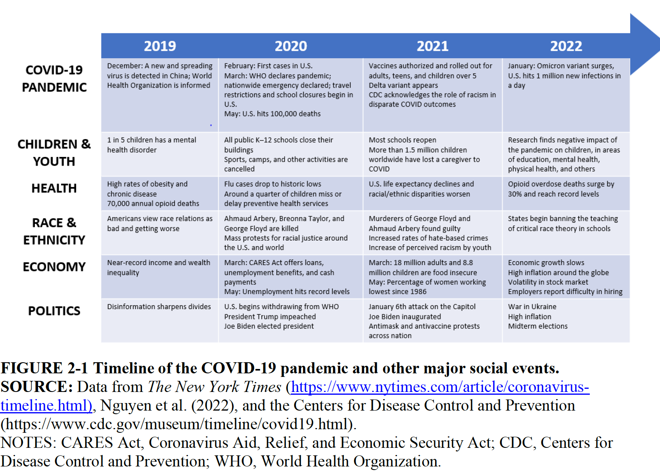

Slide 60
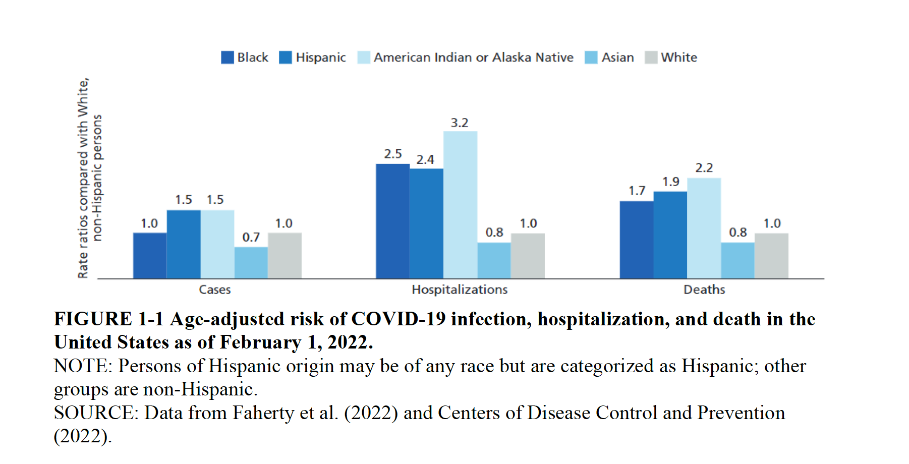

Slide 62
Participants [teachers] said that students felt the impact of the pandemic beyond academic outcomes, such as the loss of social events, like school dances and extracurricular activities.
”students have been trying to adjust to virtual learning, but it has been hard because they’re teenagers and they looked forward to things like Homecoming, which didn’t happen because of COVID regulations, or spending time talking with friends in the hallway between classes.”
“There has been this huge loss of social and emotional development that is a core part of the normal high school experience that they’ve missed because of the pandemic.”
Listening Sessions with Teachers
Notes:
English learners

Slide 63
Framework
Danger, Protection, Safety
“Signatures” of the Pandemic
Dose of Exposure
Life Course
NOTE: We may want to delete slides that Bob inserted

Slide 64
Principle of Dose of Exposure
Central to discussions of resistance, vulnerability, resilience and adjustment
Beware of analyses that do not sufficiently delineate dimensions of exposure
Need to reinforce principle of dose of exposure in our public mental health approaches
Critical intersections with health determinants, disparities, and inequities
Critical intersections with

Slide 65
CONCLUSIONS
COVID has had the greatest negative impact on the physical and mental health of youth and families who were already facing inadequate health care access, quality, and services.
These are children who are from disproportionately Black, Latino, and Native American populations; those who live in households with low incomes; and have unmet physical and mental health problems.
Notes:
These children were already facing inadequate health care access, quality, and services

Slide 66
CONCLUSIONS
Available data on the developmental, educational, physical and mental and other health and wellbeing effects of the COVID-19 pandemic are incomplete
There is still much unknown about the long-term effects that the pandemic may have on children, adolescents, young adults and their families and communities over time.
Notes:
Our data are incomplete however, and we

Slide 67
Notes:
As Velma shared, to create a pathway to recovery and rectify the underlying inequities that contributed to the pandemic’s disproportionate impact, the Committee came up with 10 recommendations that were designed to:
Address the immediate effects of the pandemic on children and families
Mitigate potential shifts in child and family life-course trajectories in the long-term
Address the need for ongoing, comprehensive child- and family data
And, help prepare for the next pandemic

