Slide 1

Preparing Racial-Ethnic Minority Children for STEM Opportunities:
Promoting Identity and Efficacy in Community Afterschool Programs
Dr. Emilie Smith
Professor,
Human Development and Family Science
Reading Room,
Zell Miller Learning Center, University of Georgia
Child Development in a Diverse Majority Society Lecture Series
Tuesday,
April 2, 2019,
11:00 pm – 12:15 pm

Slide 2
Overview
Acknowledgements –
  SRCD, Ethnic-Racial Issues Committee
  College of Family and Consumer Sciences, University of Georgia
Context – Past, Present, Future-facing
Purpose - Highlight issues, potential directions
Rationale and Significance
Theoretical/Conceptual Framework
Review of Research: STEM identity and efficacy
Implications for Practice and Policy in OST
Copyright EPS 2019 - for use by permission only

Slide 3

Historical and Current Context of University of Georgia
Georgia, the first state to charter a state-supported university, The University of Georgia, January 27, 1785
Hamilton Holmes and Charlayne Hunter-Gault - first African Americans to register at UGA, 1961.
In 1962 Mary Frances Early - first African American to earn a UGA degree, master's degree in music education
Current Events and the Ongoing struggle towards diversity
The Zell Miller Learning Center – innovative technological learning center offering computing and instructional technology
Facing the Future
Source of Photo: UGA Today, February 1, 2019

Slide 4
Rationale and Significance
Over 20% of U.S. jobs require high levels of STEM, science, technology, engineering, and mathematics knowledge (Rothwell, 2013)
Workers in STEM fields earn nearly twice the average of those outside these sectors (Brookings Institute, 2015, p.5) (Source of Figure).
Considering the workforce demands, important to prepare students for STEM careers (Xue & Larson, 2015).
U.S. exports 60% of STEM services, has 632 billion trade deficit, lags behind in industries that were formerly strengths e.g. communication, computers, motor vehicles (Brookings Institute, 2015).

Slide 5
The STEM Pipeline: Issues and Advances
Elementary School
Home
School
Middle School
Pre-algebra prep
High School
Advanced Science Courses
OST
College Prep
Counseling
College
Research Experiences
Mentoring
Career
INCLUDES, LSAMP
Salaries
Mentoring
Promotion
Identity, Efficacy

Slide 6
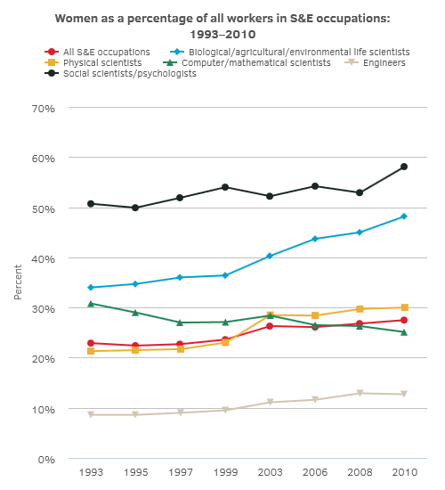
Trends: Gender and STEM:
(Source: NSF, 2017)
Notes:
Women well represented now in social science/psychology – 50%+
Comprise little over 10% of engineers
Better represented in biological/agricultural/environmental sciences
Decreasing in representation among computer and mathematical scientists – initiatives by Sony -

Slide 7
College, STEM Degrees by
Racial-Ethnic Representation
Racial and ethnic distribution of U.S. residents, and of employed individuals in S&E occupations, with S&E degrees, and with college degrees: 2015
(Percent)
Race and ethnicity | S&E occupations | S&E highest degree holders | College degree holders | U.S. residential populationª
Total (number) | 6,407,000 | 13,497,000 | 45,941,000 | 231,875,000
American Indian or Alaska Native | 0.2 | 0.3 | 0.3 | 0.6
Asian | 20.6 | 15.1 | 8.7 | 5.5
Black | 4.8 | 6.4 | 7.5 | 11.8
Hispanic | 6.0 | 8.4 | 8.2 | 14.9
Native Hawaiian or Other Pacific Islander | 0.2 | 0.3 | 0.4 | 0.1
White | 66.6 | 67.6 | 72.9 | 65.6
More than one race | 1.6 | 1.9 | 2.0 | 1.5
Source(s):Census Bureau, American Community Survey (ACS) (2015); National Science Foundation, National Center for Science and Engineering Statistics, National Survey of College Graduates (NSCG) (2015), https://www.nsf.gov/statistics/srvygrads/.

Slide 8
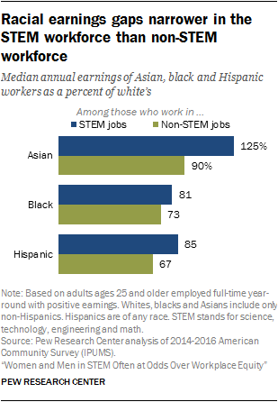
Stem Participation and Earnings Gap

Slide 9
The issue of access and preparation
According to the U.S. Department of Commerce (Beede, 2011) “non-Hispanic Blacks and Hispanics each account for six percent of all STEM workers, but 11 percent and 14 percent, respectively, of overall employment.”
“Women make up 48 percent of the workforce but only 24 percent of STEM jobs.”
These disparities begin early, according to Malcolm (2012): “Thirty percent of African-Americans, Latinos and American Indians/Native Alaskans in the fourth grade tested below the basic proficiency in math, compared with 8 percent of Asian-American/Pacific Islander and 9 percent of Caucasian fourth-graders.
The STEM pipeline begins in elementary school affecting the possibilities for later STEM and high school college preparatory classes.

Slide 10
Theoretical and Conceptual Framework

Slide 11
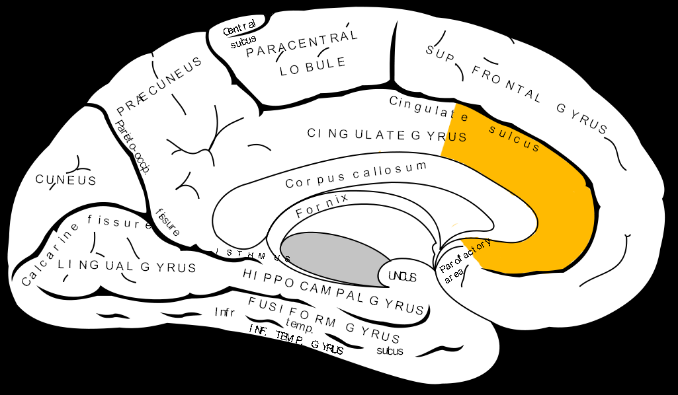
So how does mindset matter?
Stereotype Threat (Steele, Spencer, & Aronson, 2002)
  When told that your gender or race is irrelevant – scores are similar
  When told your gender or race matters – scores are different by group
  Researchers found that heightened activation in the ventral stream of the anterior cingulate cortex (ACC), appears to play a role in a wide variety of autonomic functions, such as regulating blood pressure and heart rate.
Figure Source: Brodman, 1909; K. Zilles, 2018

Slide 12
Learned helplessness
In Dweck’s (1975) early work, she pointed out that learners respond in two distinct ways: helplessly or with mastery.
Helpless responses generally involve the arrangement of avoidance and the dissolution of effective performance.
Mastery, however, involves the pursuit and preservation of effective performance.
Over time, this notion was challenged as she started to see students with shared levels of ability and pursuits for mastery result in different places as it concerned persistence in challenging environments.

Slide 13
The Role of Growth Mindset
Implicit theories came about to explain why students with shared abilities had different goals (Yeager & Dweck, 2012; Dweck & Leggett, 1988).
Two types of implicit theories: entity and incremental.
Entity theory - intellectual abilities are a fixed and unchangeable, fixed mindset.
Incremental theory - intellectual ability is something that is malleable and can be changed over time, growth mindset.
Fixed mindset – when faced with unfavorable outcomes, more likely to embody patterns of helplessness.
Growth mindset - often remain persistent and engaged when needing to raise competency levels.
If you can’t make a mistake, you can’t make anything.”
~Marva Collins, Educator

Slide 14
Growth Mindset and STEM
Growth mindsets enhance senses of belonging to a male-dominated discipline (Hill et al., 2017; Stout & Blaney, 2017)
Ability beliefs predict STEM career attainment (Seo, Shen, & Alfaro, 2018)
Ability beliefs at a young age have a powerful impact on perceptions of competency and task persistence in physics, engineering, mathematics, and computer science (PEMC) at an older age (Nix, Perez-Felkner, & Thomas, 2015 ).
Interestingly, meta-analyses (studies of all the studies) have been conducted to examine the impact motivational interventions have on academic outcomes.
  One meta-analysis lays out that motivational interventions are generally effective (Lazowski & Hulleman, 2016)
  Another meta-analysis claims that motivation models may not be as effective as they may appear (Sisk et al., 2018).
Why?

Slide 15
Is MINDSET Enough? The Role of Context and Adults
Relational-developmental-system models - the value of relationships in youth development (Lerner, 2015).
Quality of youth contexts serve as “developmental assets” that foster competence, connection, caring, cultural values (Scales et al., 2001; Lehman, Petersen, Smith and the SRCD ERI and International Committees, 2018; Smith, Witherspoon, & Osgood, 2018)
Youth agency and engagement (Larson & Angus, 2011)
Efficacy building experiences (Bandura, 2000)

Slide 16
Background of Identity, Efficacy Research
Identity of juvenile offenders in family-community alternatives
Identity – racial-ethnic identity and socialization among elementary children
  Relationships to self-esteem (Smith & Brookins, 1997)
  Relationships to academic achievement (Smith et al., 2003; C. Smith et al., 2009)
  Relationships to other outcomes
Building Opportunities for Positive Youth Development
  Collective Efficacy – (Smith et al., 2013)
  Interest in social and occupational opportunities, “possible selves” (Oyserman, Bybee, & Terry, 2006)
  Multiple identities (gender, racial-ethnic, occupational)

Slide 17
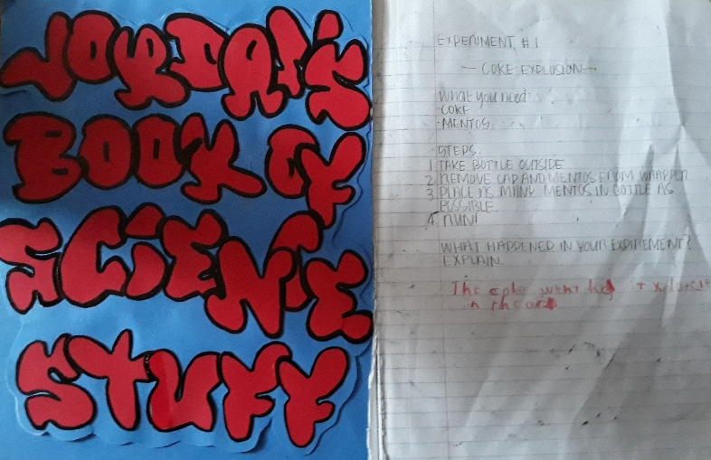
Factors Related to Early STEM Interest
Home
  Educational background of parents – particularly scientists
  Science “hobbies“
  Summer Camps
School
  Science courses
Out of School Time (OST)
  Exposure to STEM – project based learning, inquiry

Slide 18
Elementary School STEM Access
Due to NCLB and accountability demands, science often receives less attention in school than reading or math.
The typical elementary school class spends,
  about 20 minutes a day on science instruction,
  compared to 60 minutes on mathematics and 90 minutes on reading/language arts (Horizon Research, 2013).
Though students have reading and math daily in elementary school, science is typically once or a few times weekly.

Slide 19
Teacher Background and Efficacy in Science Across K-12 (Horizon Research, 2013)

Slide 20

School Factors Relevant to STEM
Counseling (Nikisher, 2016)
  Caseload and administrative support for counselors
  Youth and parent agency
  Support for College Preparation
  Training in STEM preparation
  Expectancies and counseling processes
  Learning and instructional processes (Ladson-Billings, 2006, 2007)
CASE EXAMPLE: From “The Boy Who Cartwheels and Walks” to the “Man on the Move”
  (Current Analyst and Organizational Strategy Consultant)

Slide 21

School Opportunities for STEM courses
Exposure to STEM courses is greater predictor of STEM persistence than grades (Wang, 2013)
The role of tracking in sustaining disparities – “enhances or limits access” (Oakes, Keeping Track, 1985, 2005)
In a sample of 12,500 students - broadening participation in Algebra result in small benefits for lower achieving students and no loss for students in heterogenous compared to homogenous classrooms (Gamoran & Hannigan, 2000)
Importance of data, methods, analyses to understand higher level school and setting effects (e.g. HLM, Bryk & Raudenbush, 2002)

Slide 22
STEM Course Takings and Offerings

Slide 23
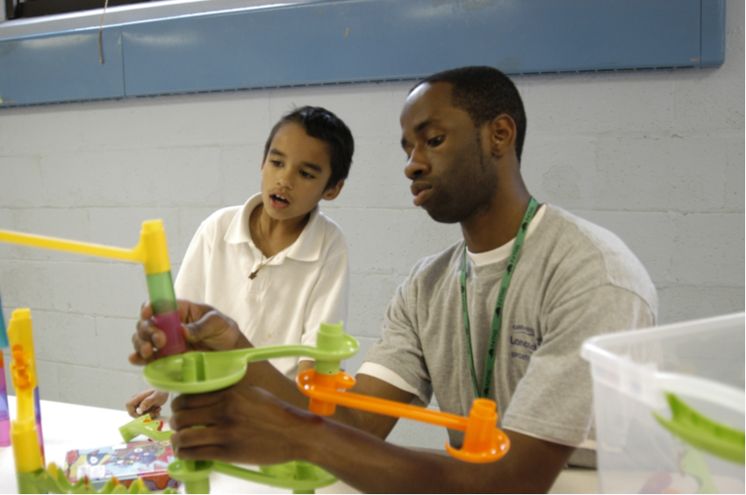
STEM and Out of School Time (OST)
Home, school, and during out-of-school time all contribute to STEM interest for children across race-ethnicity (Calabrese Barton, 2013; Kang et al., 2019)
24 percent of African‐American, 21 percent of Hispanic and 16 percent of Native American children attend afterschool programs, compared to the national average of 15 percent (Afterschool Alliance, 2009)
Out of school programming enhances student behavioral outcomes and performance in reading and math (Krishnamurthi, Ballard, & Noam, 2014; Smith et al., 2017; Vandell et al., 2018)
OST programs foster significant interest and potential identity as a scientist (Aspires Project, 2014)
Youth participating in 4-H were twice as likely to participate in STEM during out-of-school time (Lerner et al., 2005)

Slide 24
STEM Identity and Efficacy:
Directions for Practice and Policies
Role of STEM identity (Byars-Winston and Griebel Rogers, 2019)
Single sex classrooms, STEM X Gender, stereotype threat (Bowe et al., 2017)
Promoting STEM identity among AA males (Brown et al., 2017)
Integrating STEM into elementary curriculum (Yoon et al., 2014)
Role of activitiy quality (e.g. project based learning) on STEM identity, interest (Kang et al., 2019; Simpkins, Davis-Kean, & Eccles, 2006)
Support Adult efficacy and competencies

Slide 25
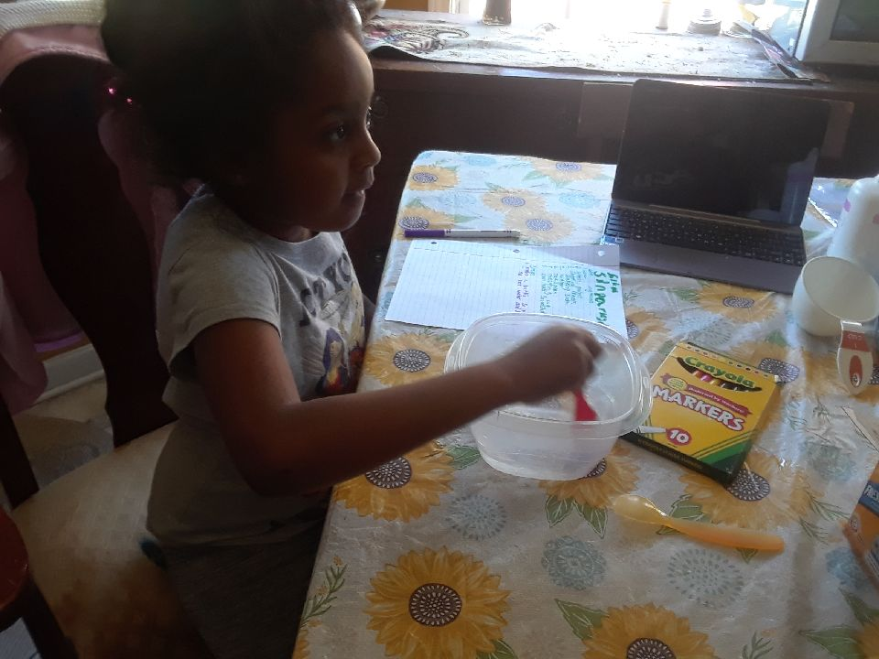
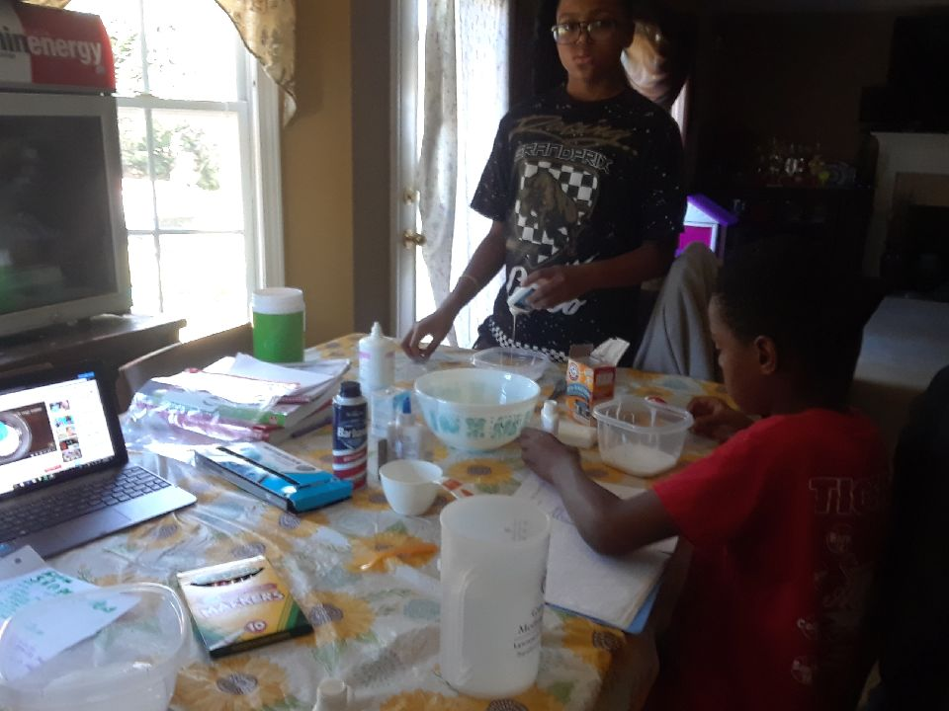
Questions/Discussion
Email:
Emilie.Smith@uga.edu

